Slide 1
Aim 5: DESeq
Differential abundance analysis of high vs low nutrient consumption in PD and Control groups.

Slide 2
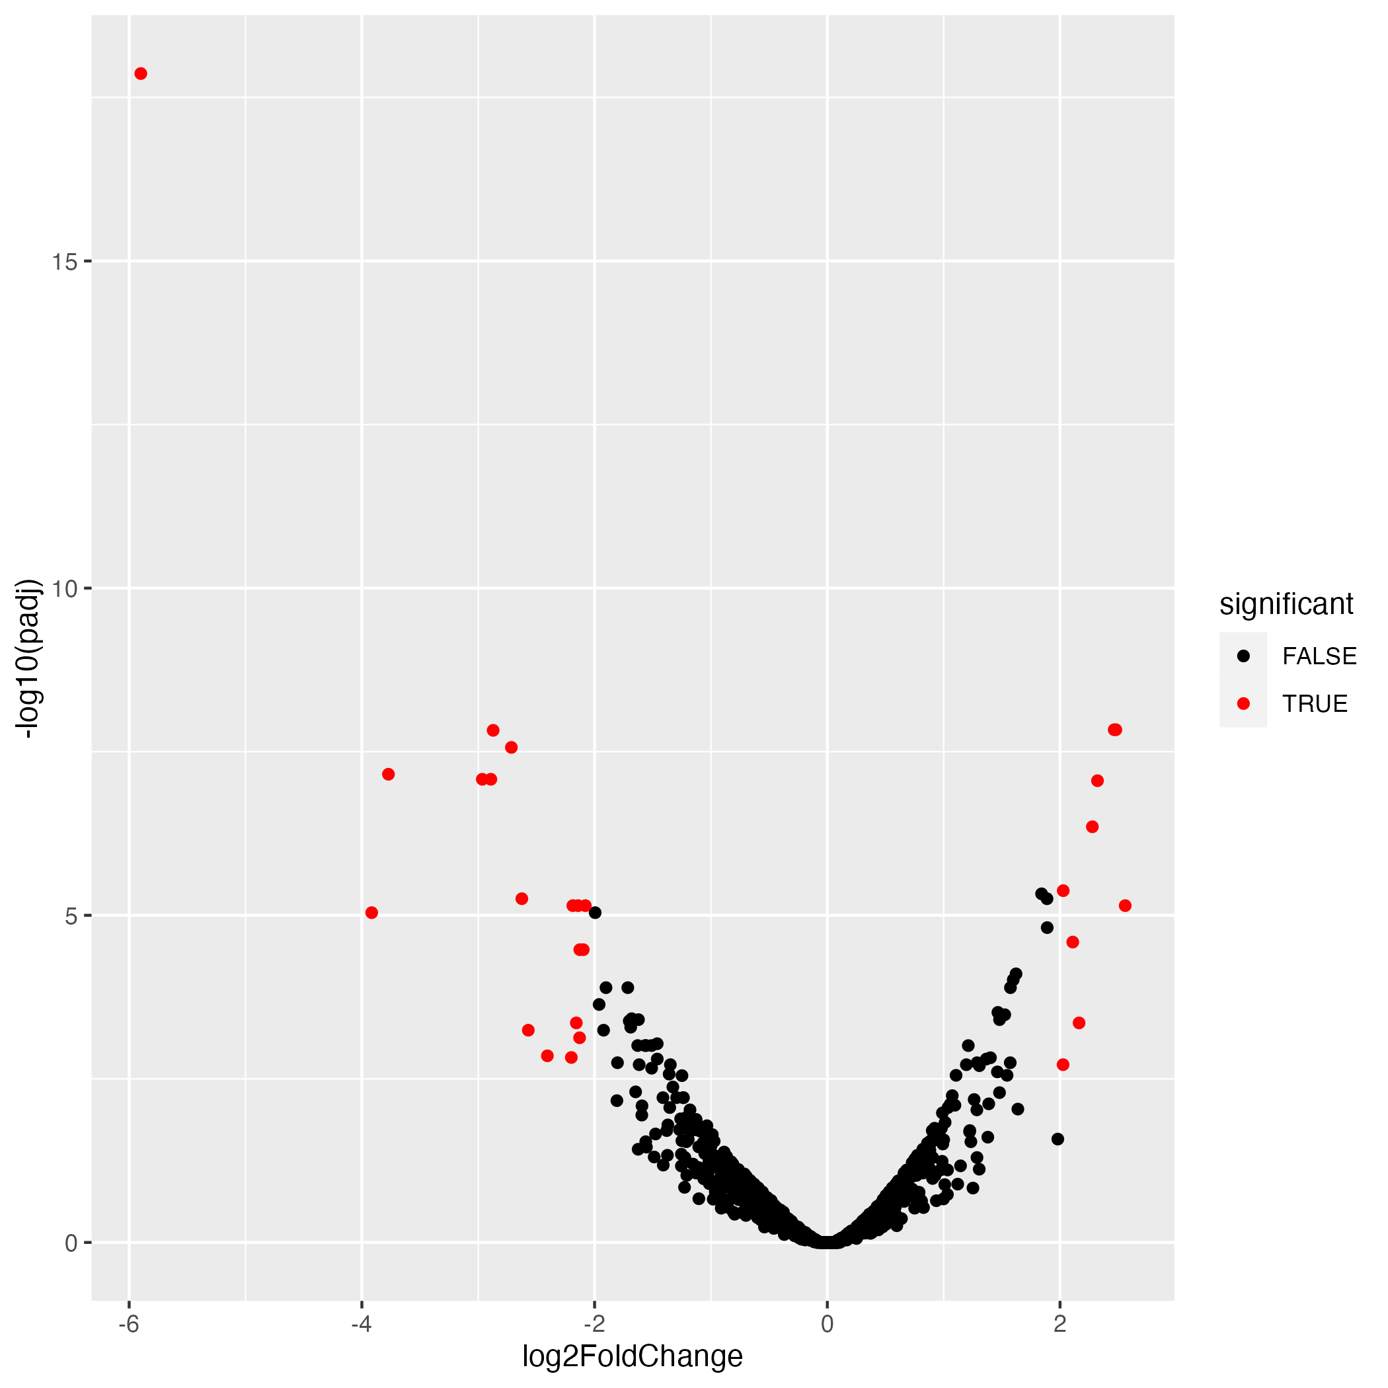
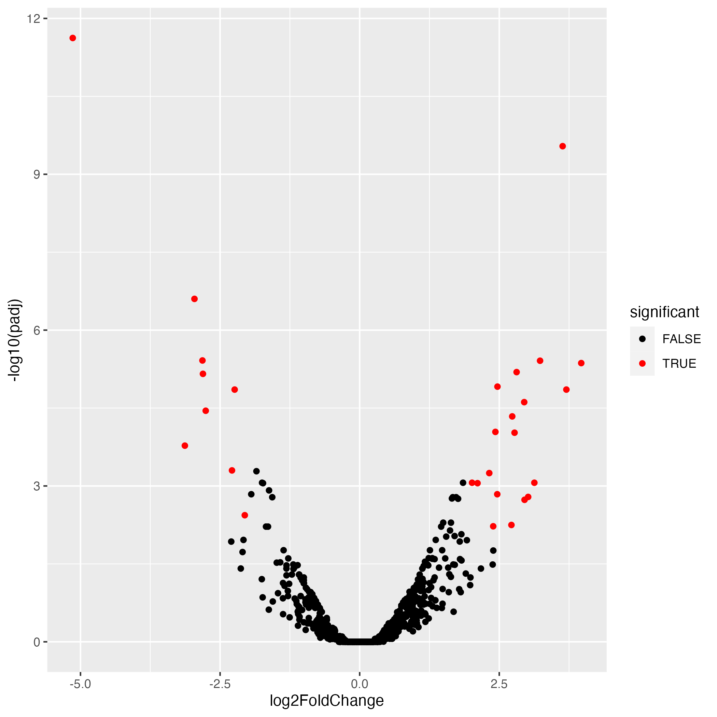
Coffee Volcano Plots
PD
Control

Slide 3
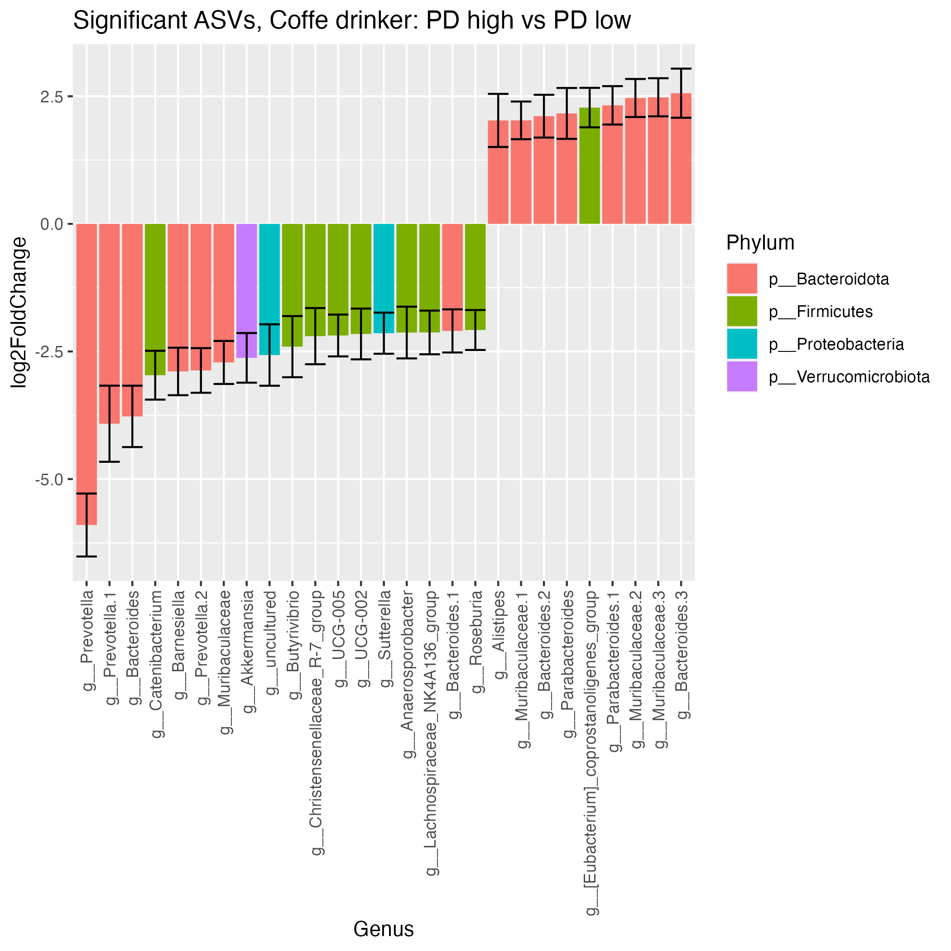
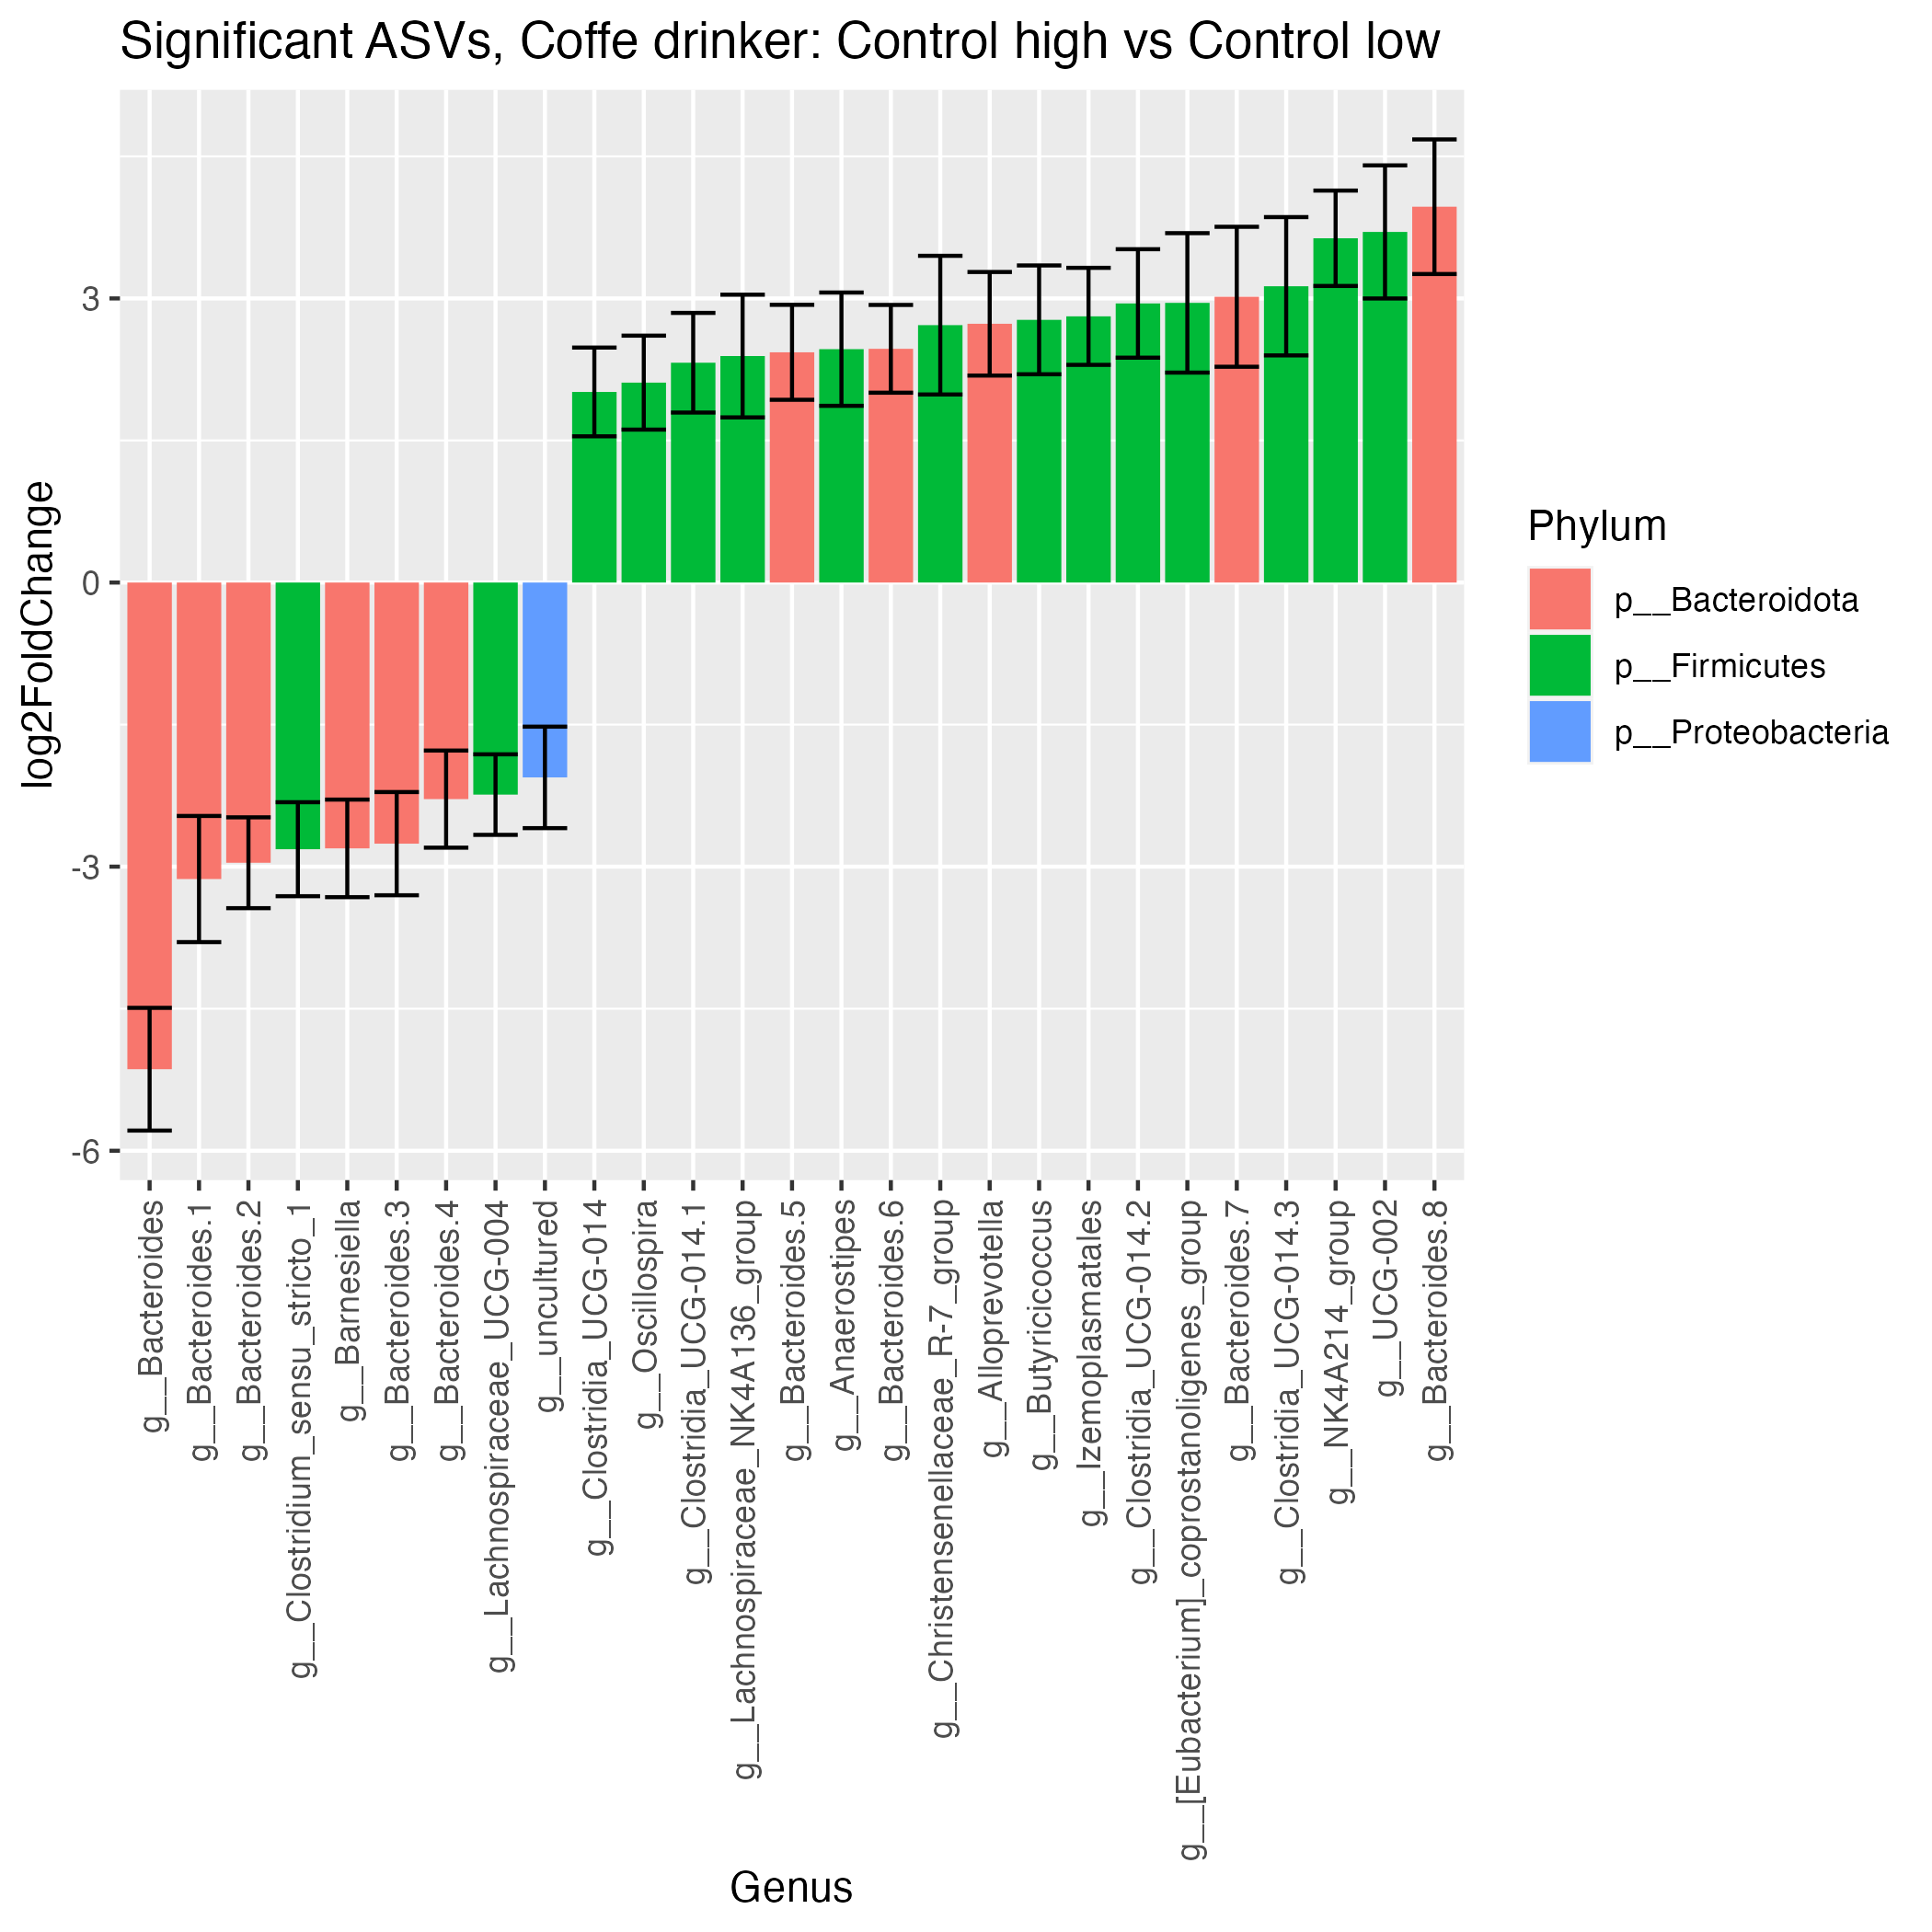
Coffee Significant ASVs
18
9
9
18

Slide 4
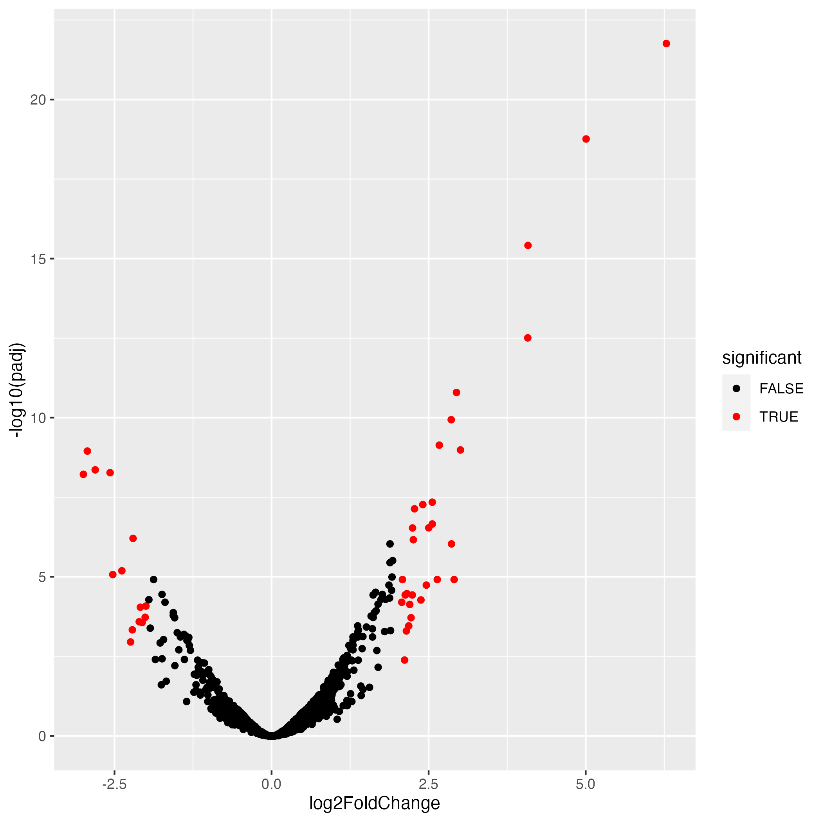
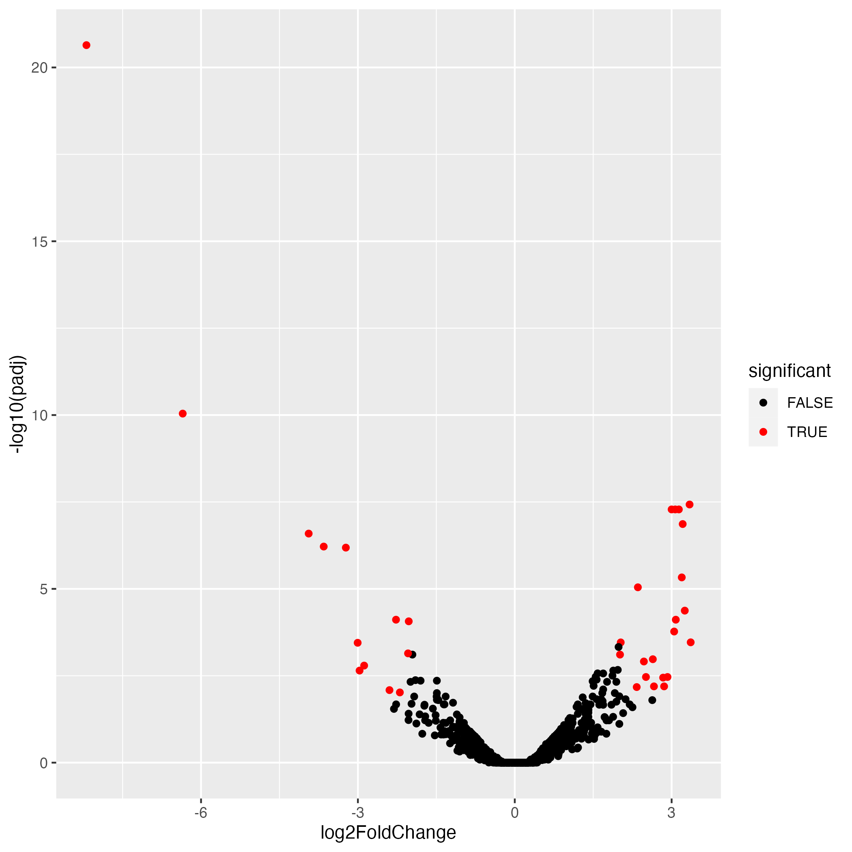
Fructose Volcano Plots
PD
Control

Slide 5
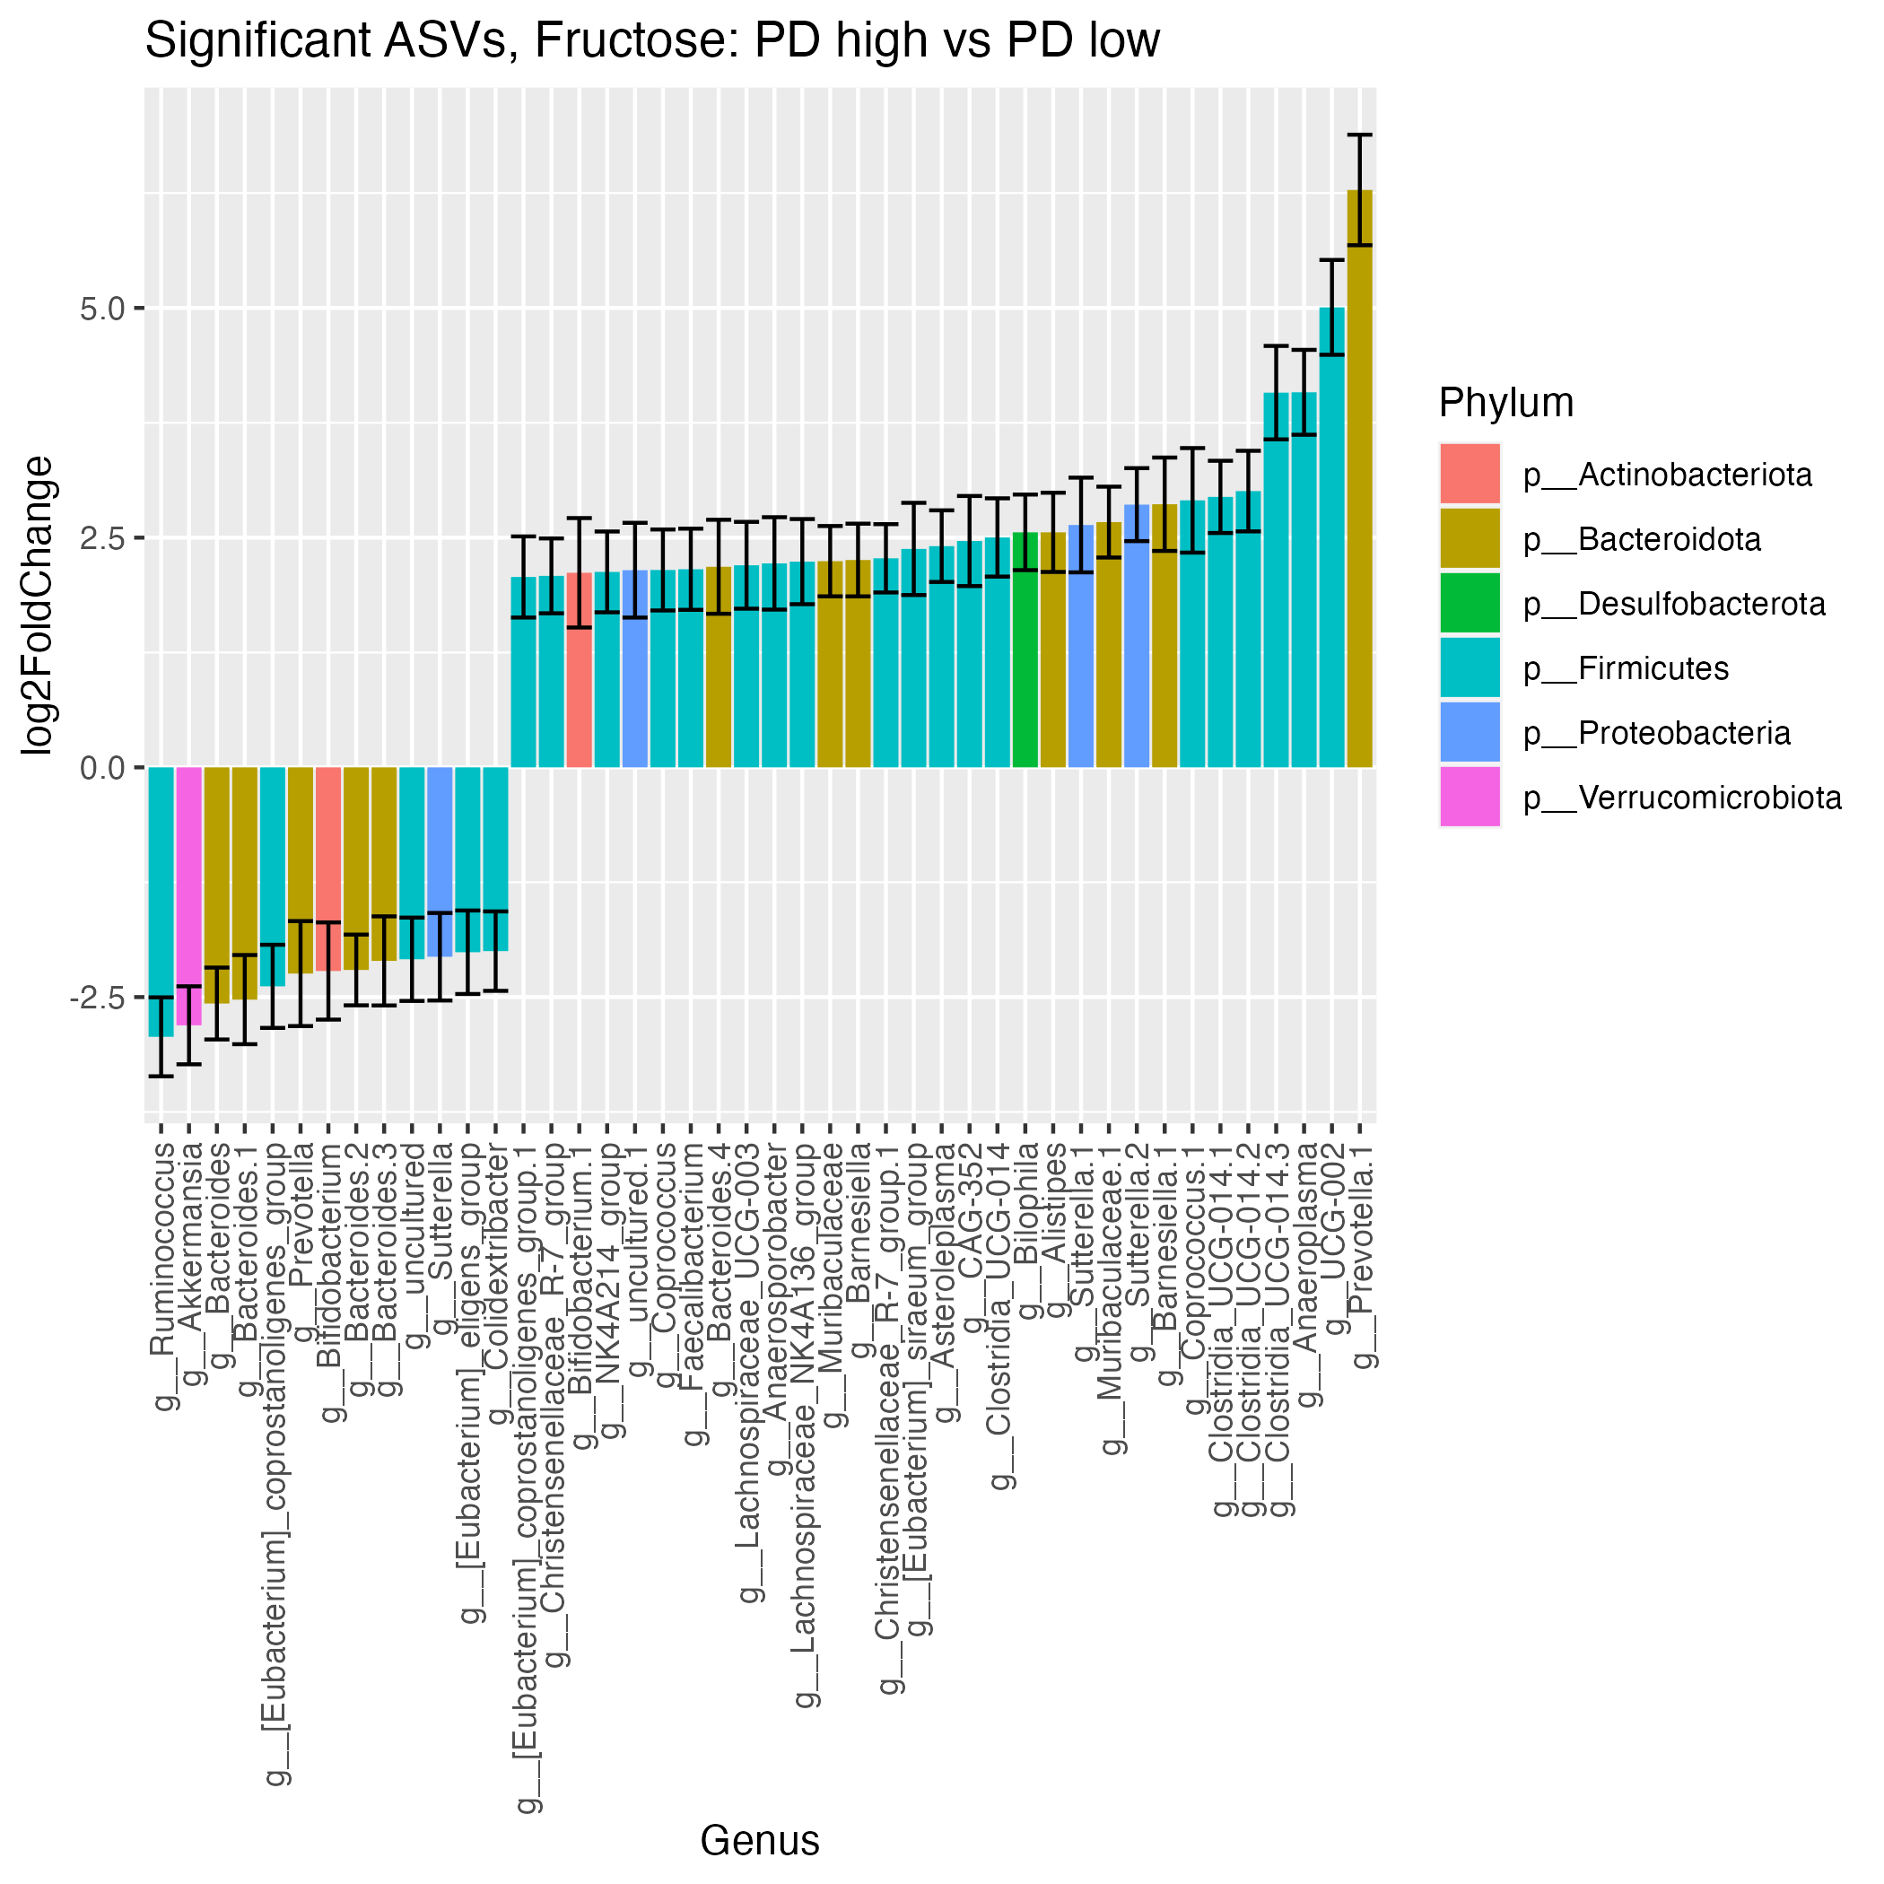
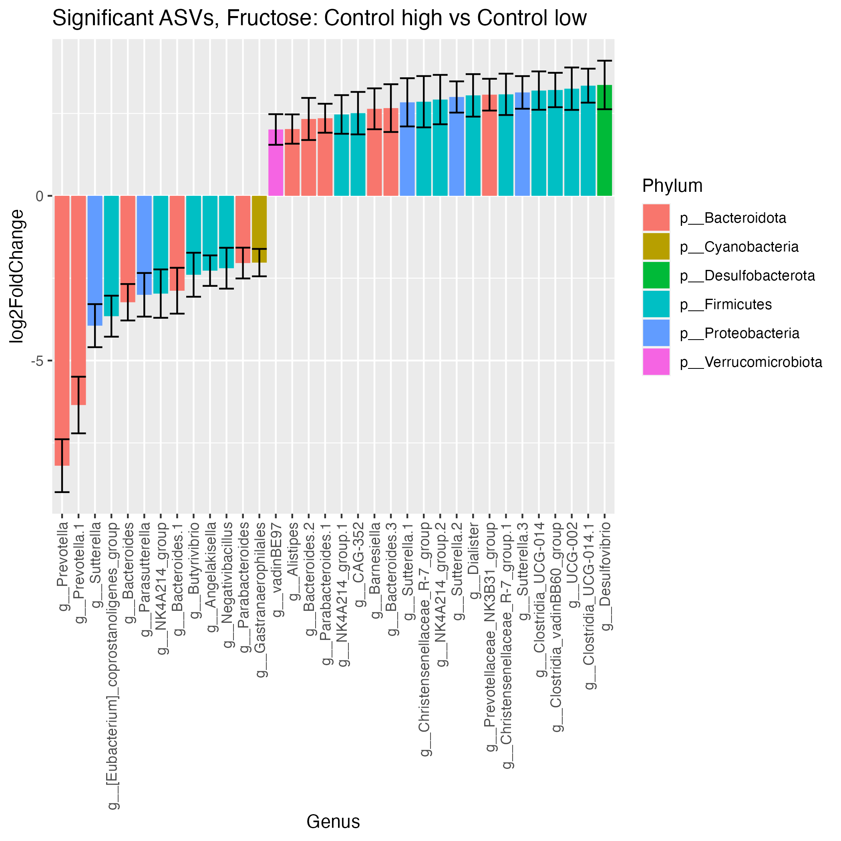
Fructose Significant ASVs
13
21
13
31

Slide 6
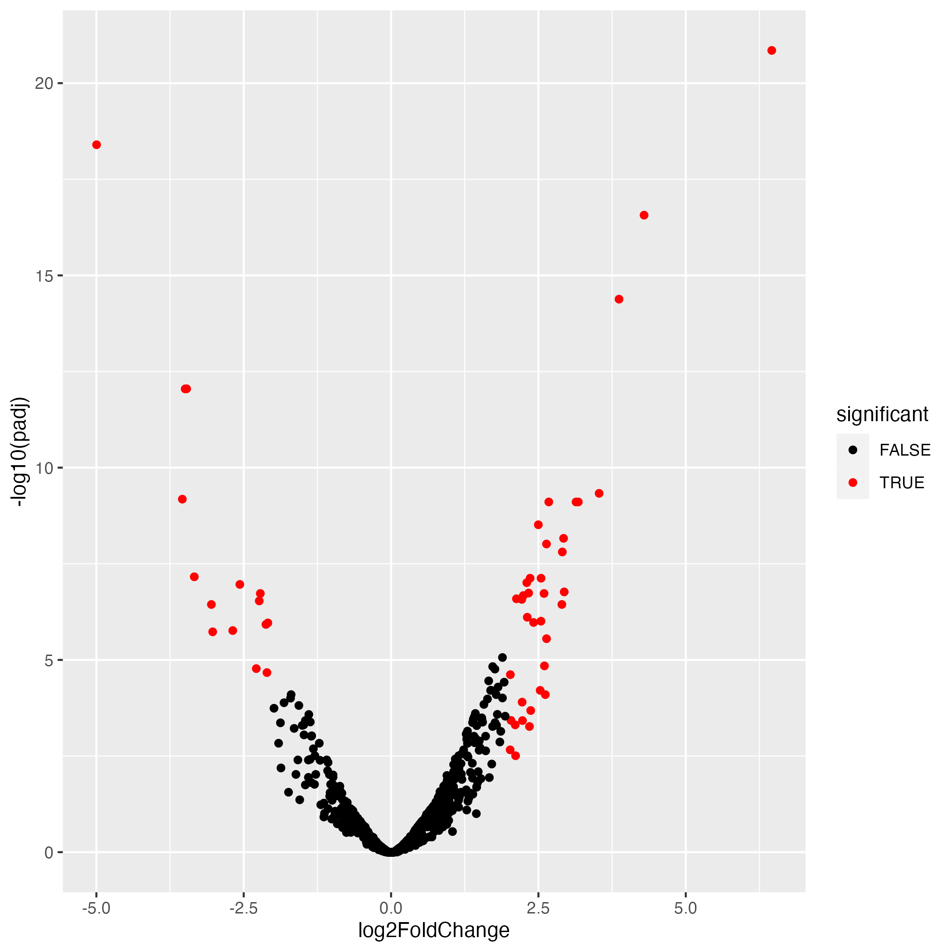
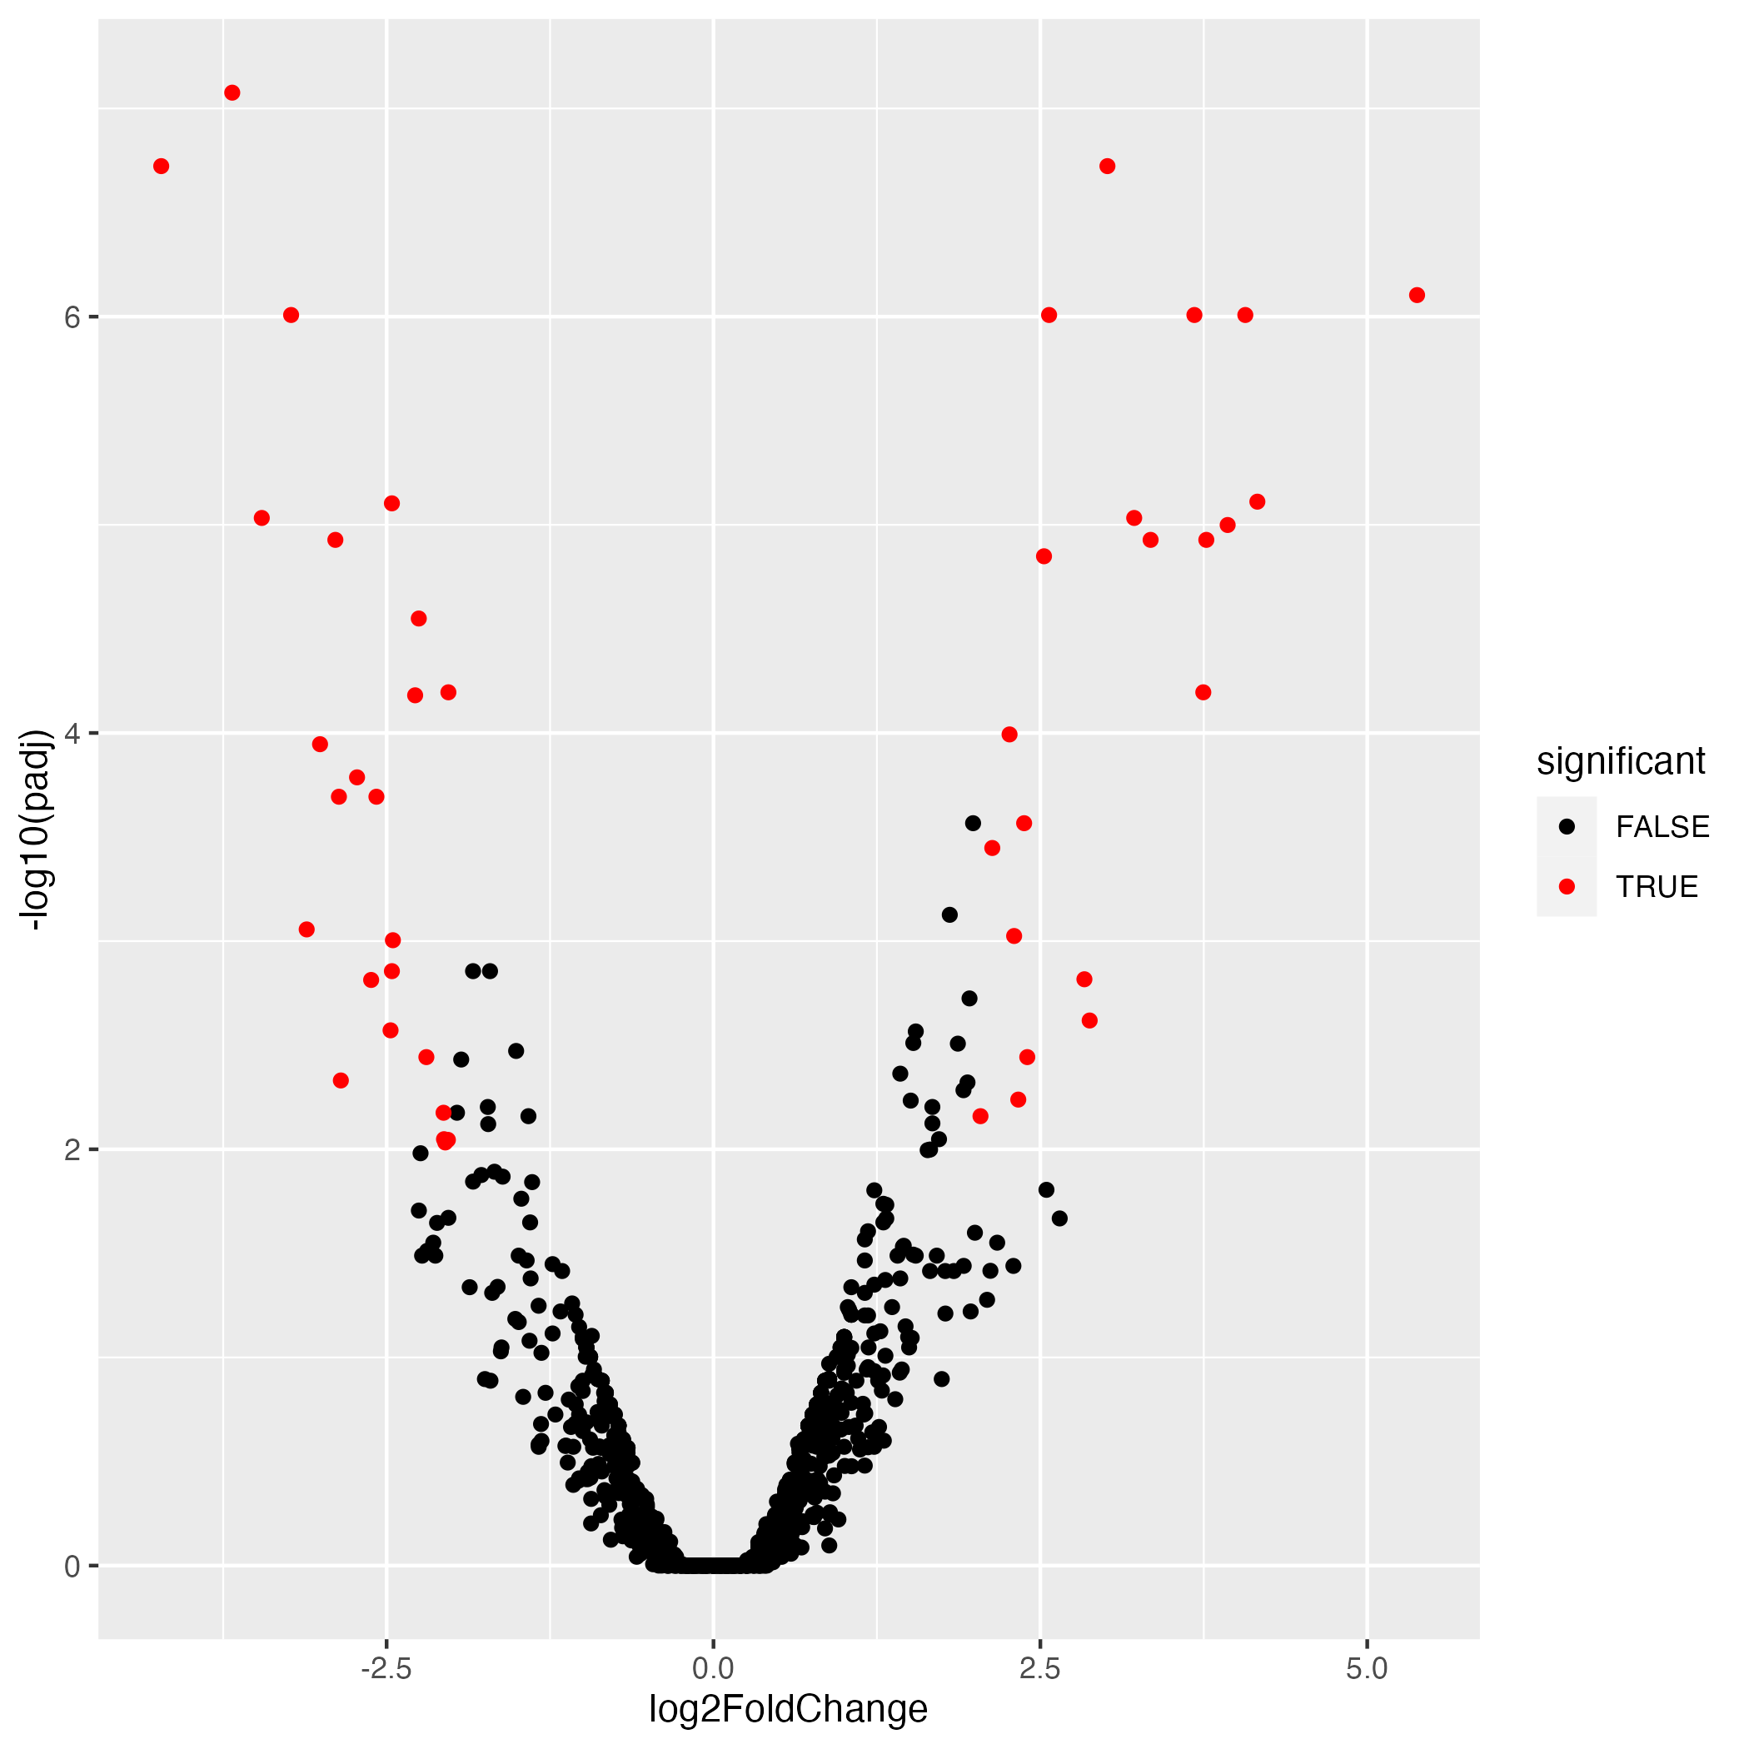
NSP Volcano Plots
PD
Control

Slide 7
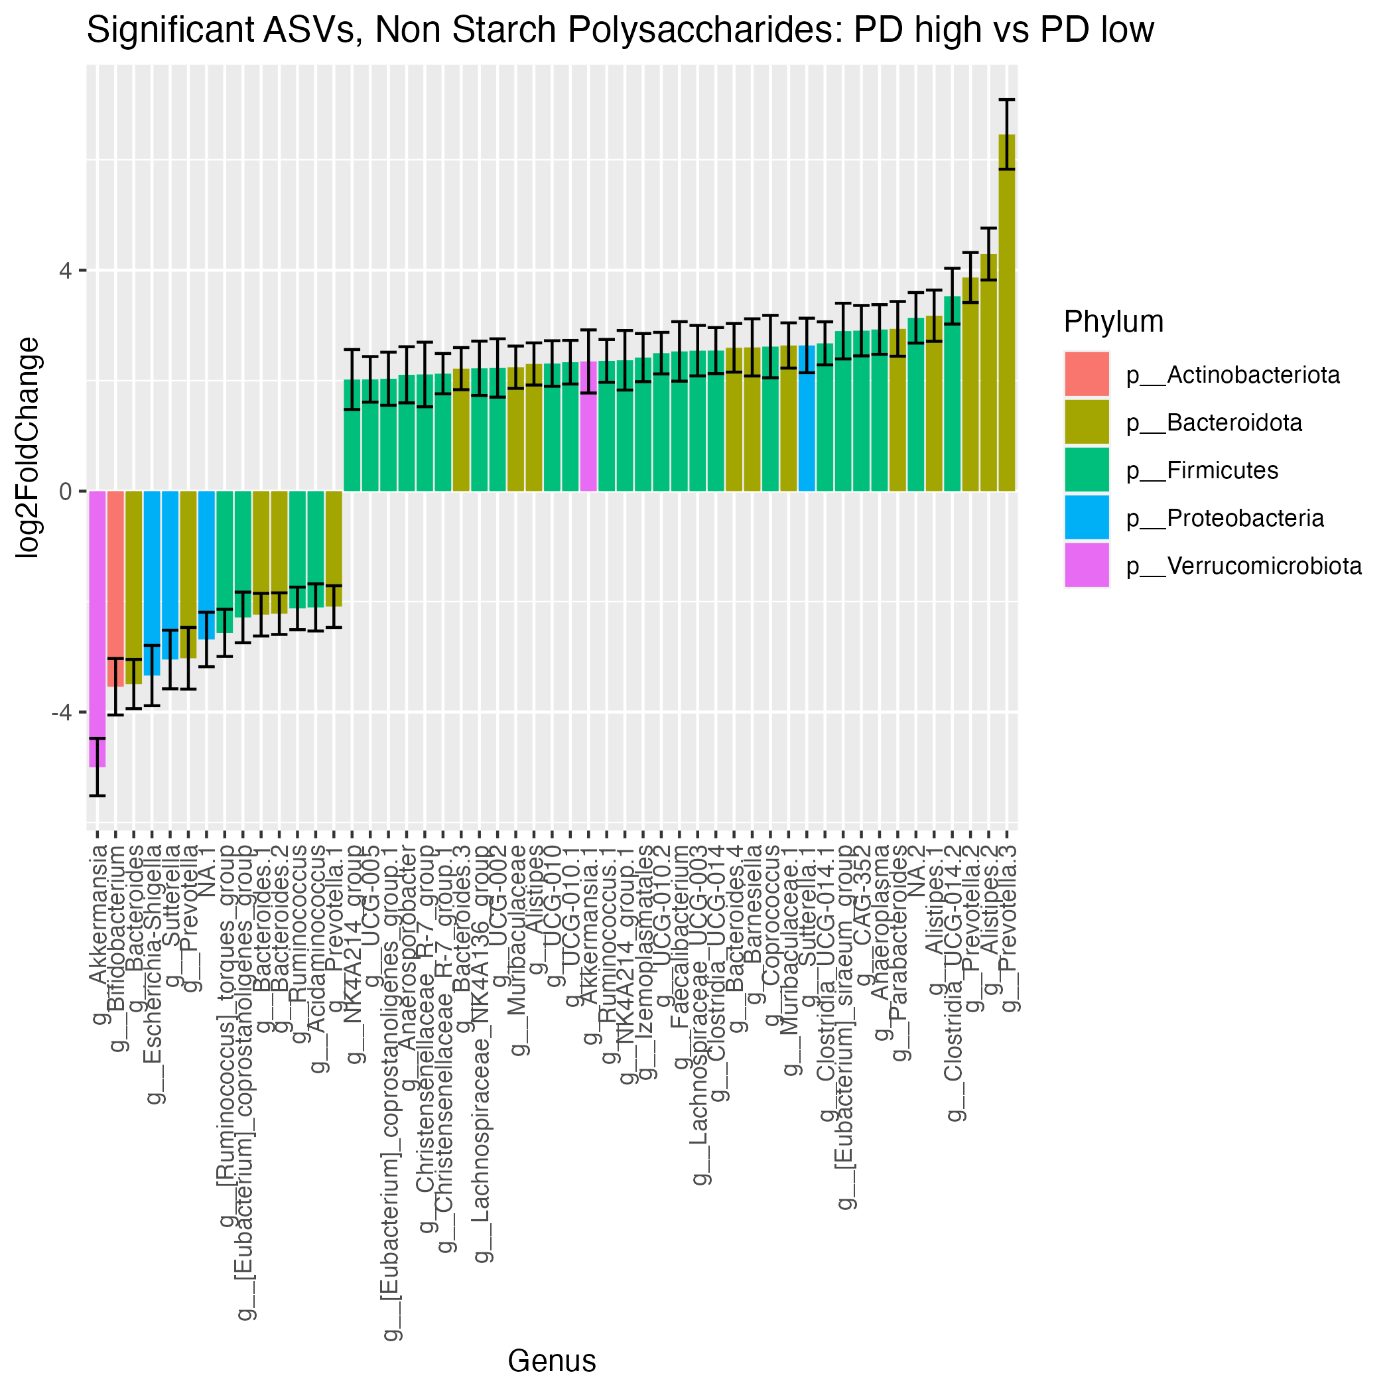
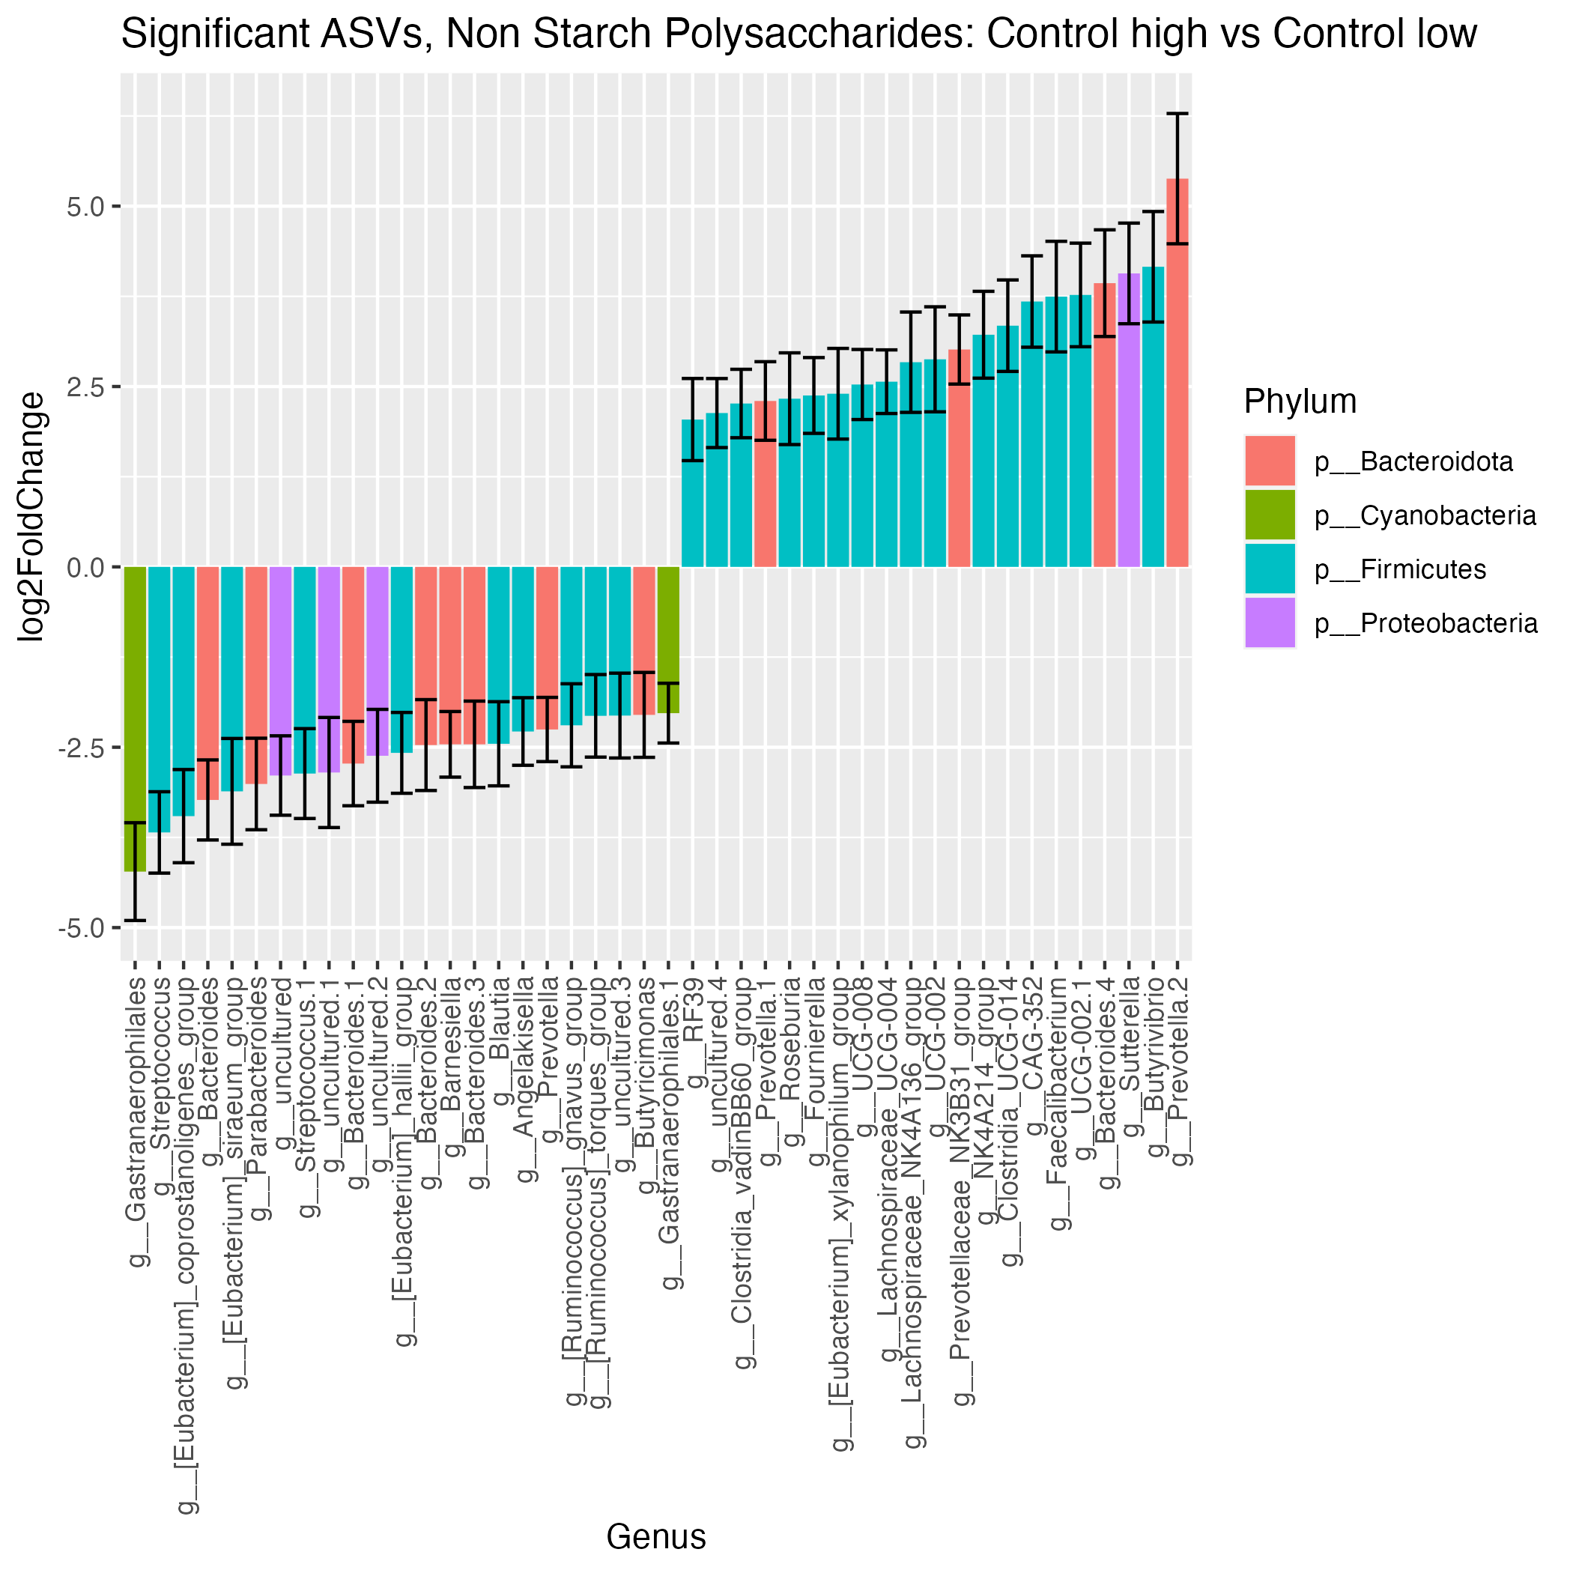
NSP Significant ASVs
14
23
37
21

Slide 8
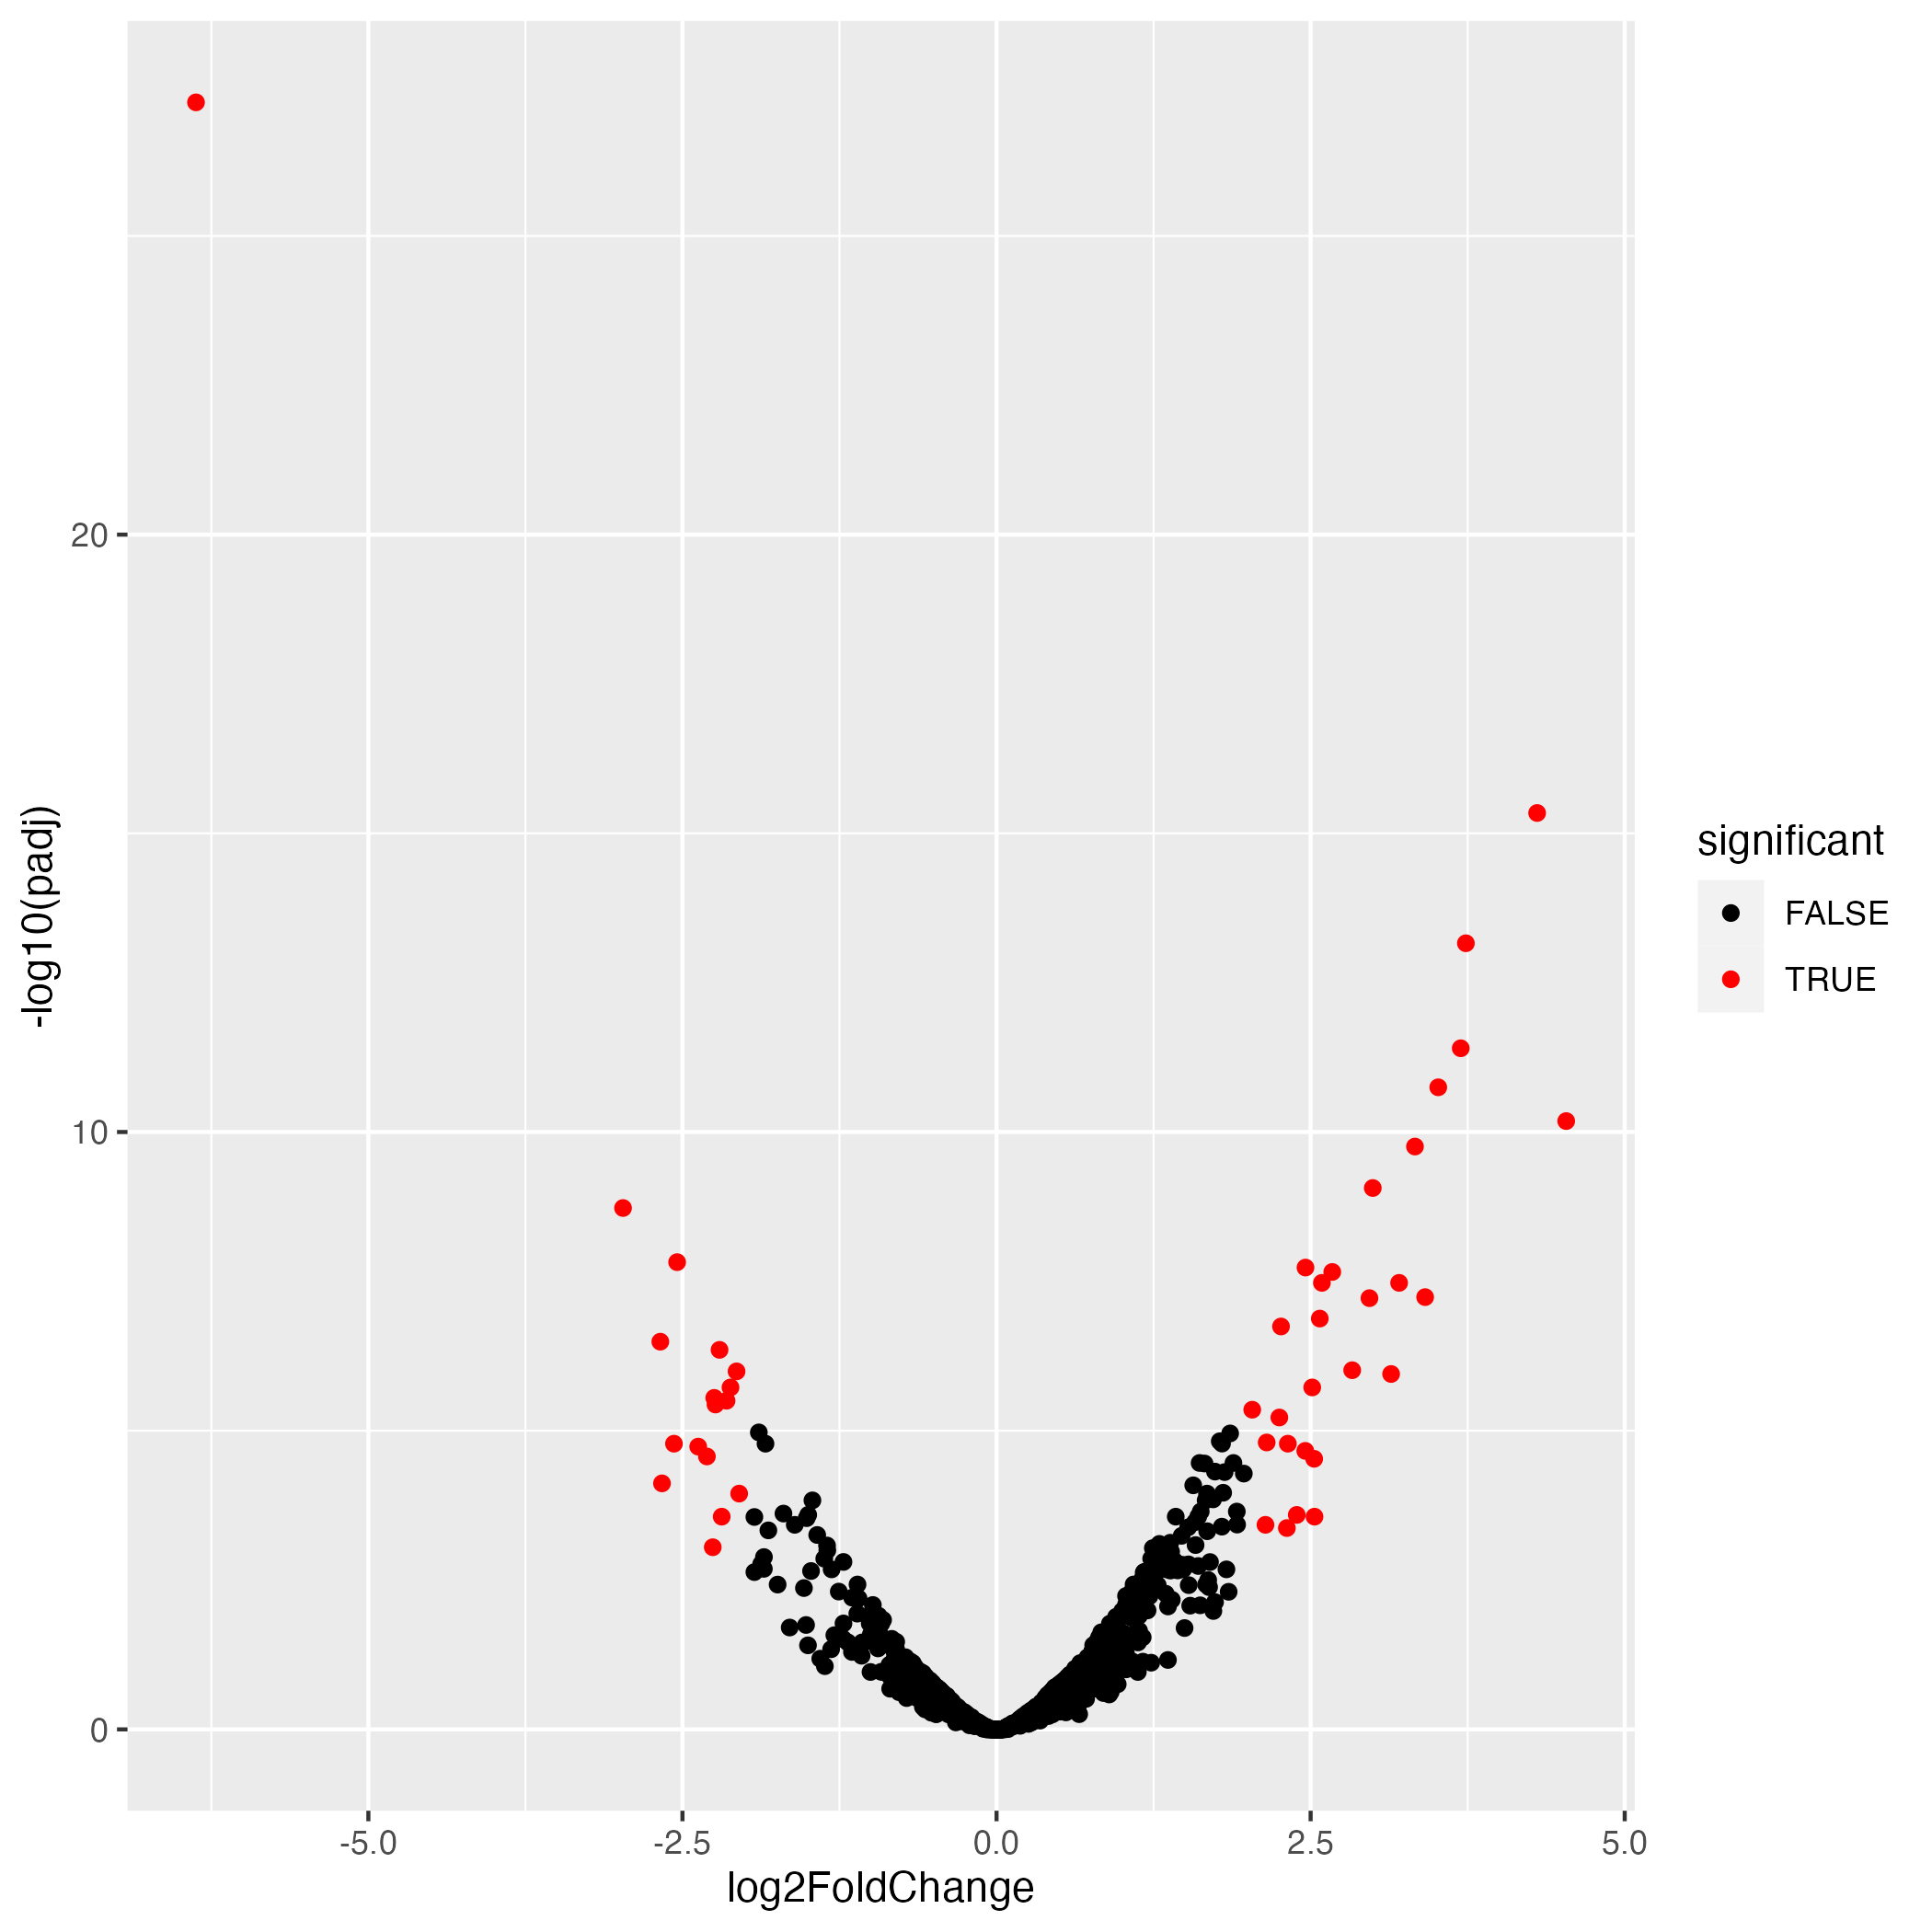
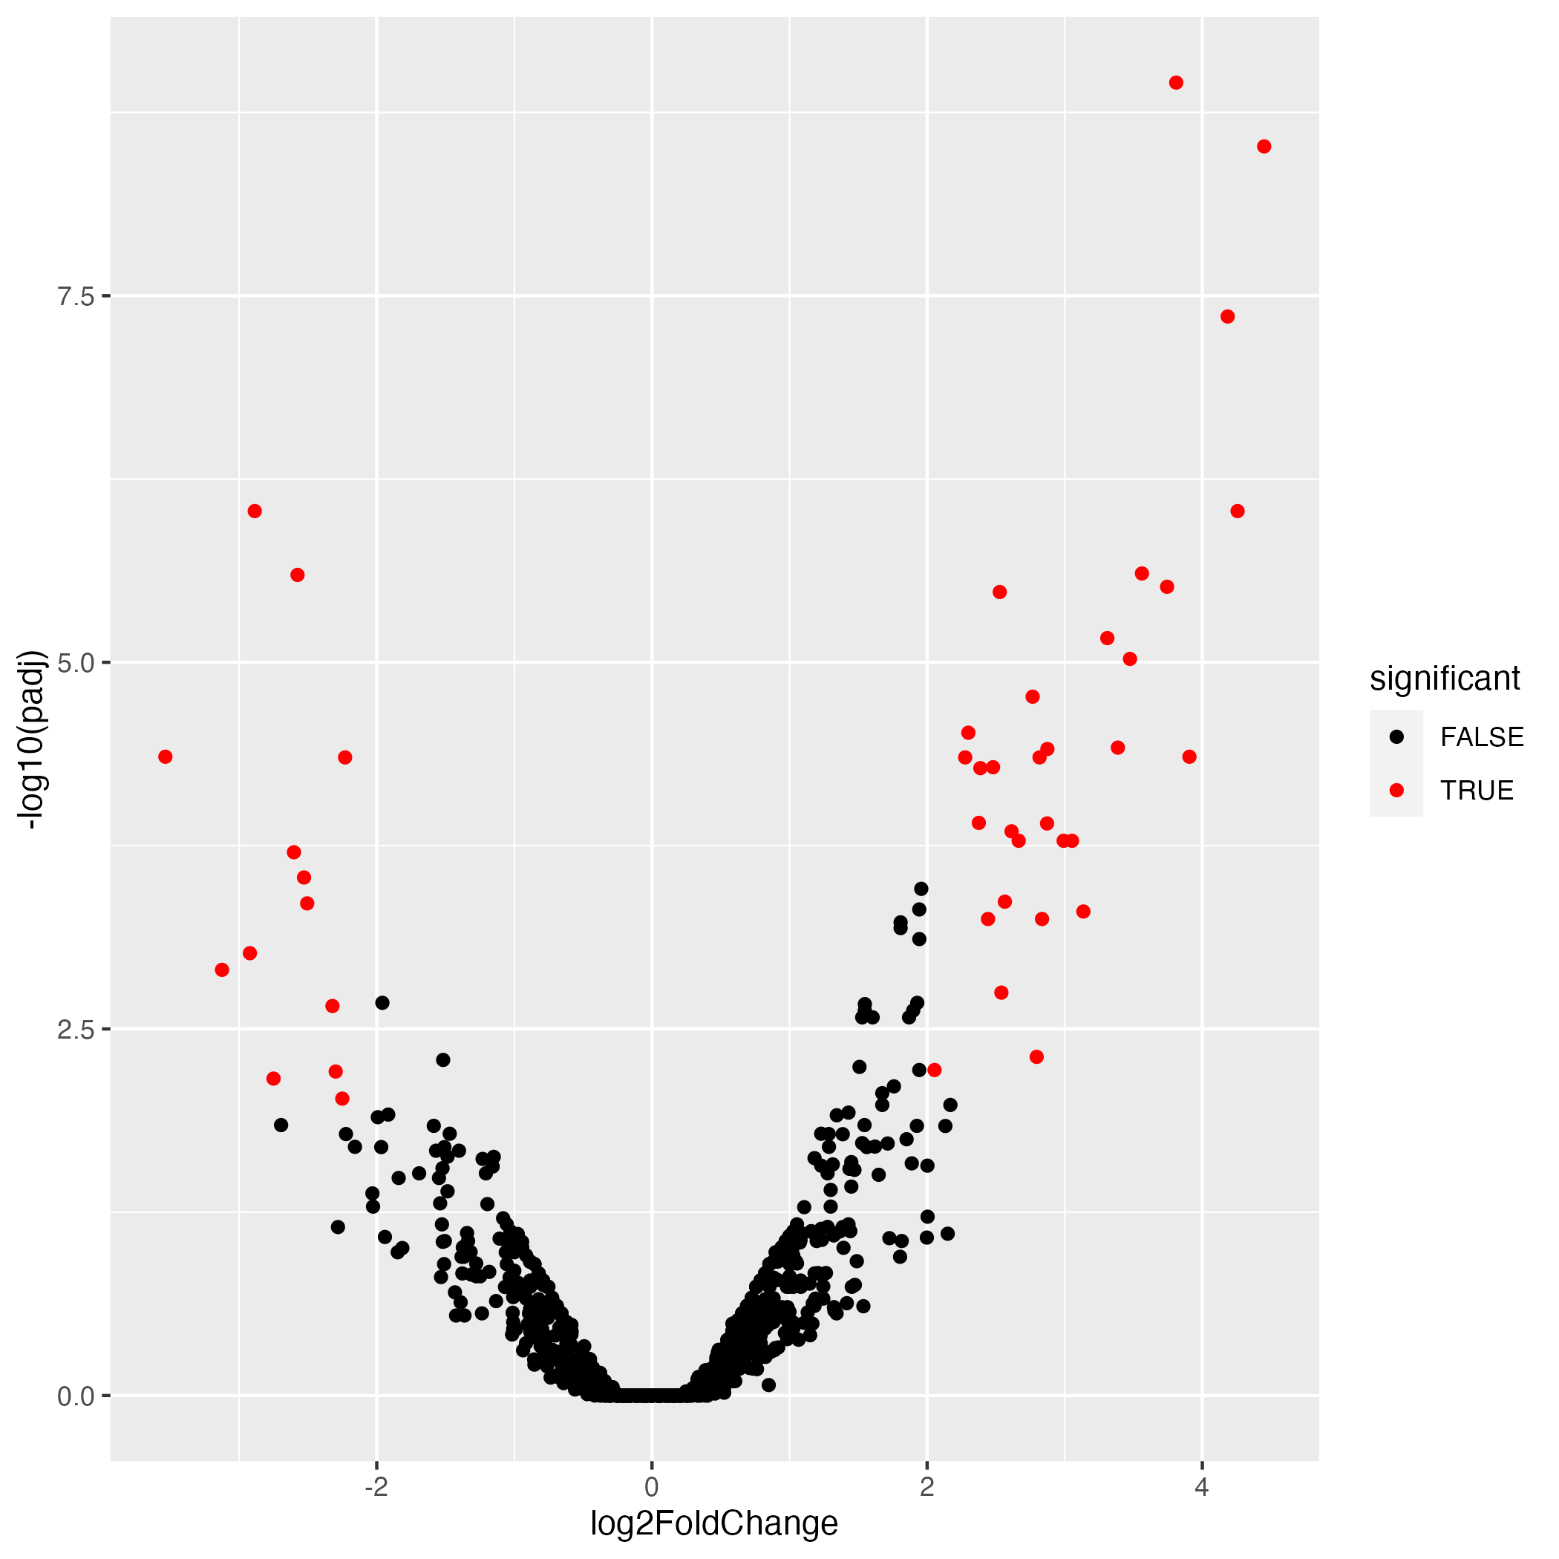
Folate Volcano Plots
PD
Control

Slide 9
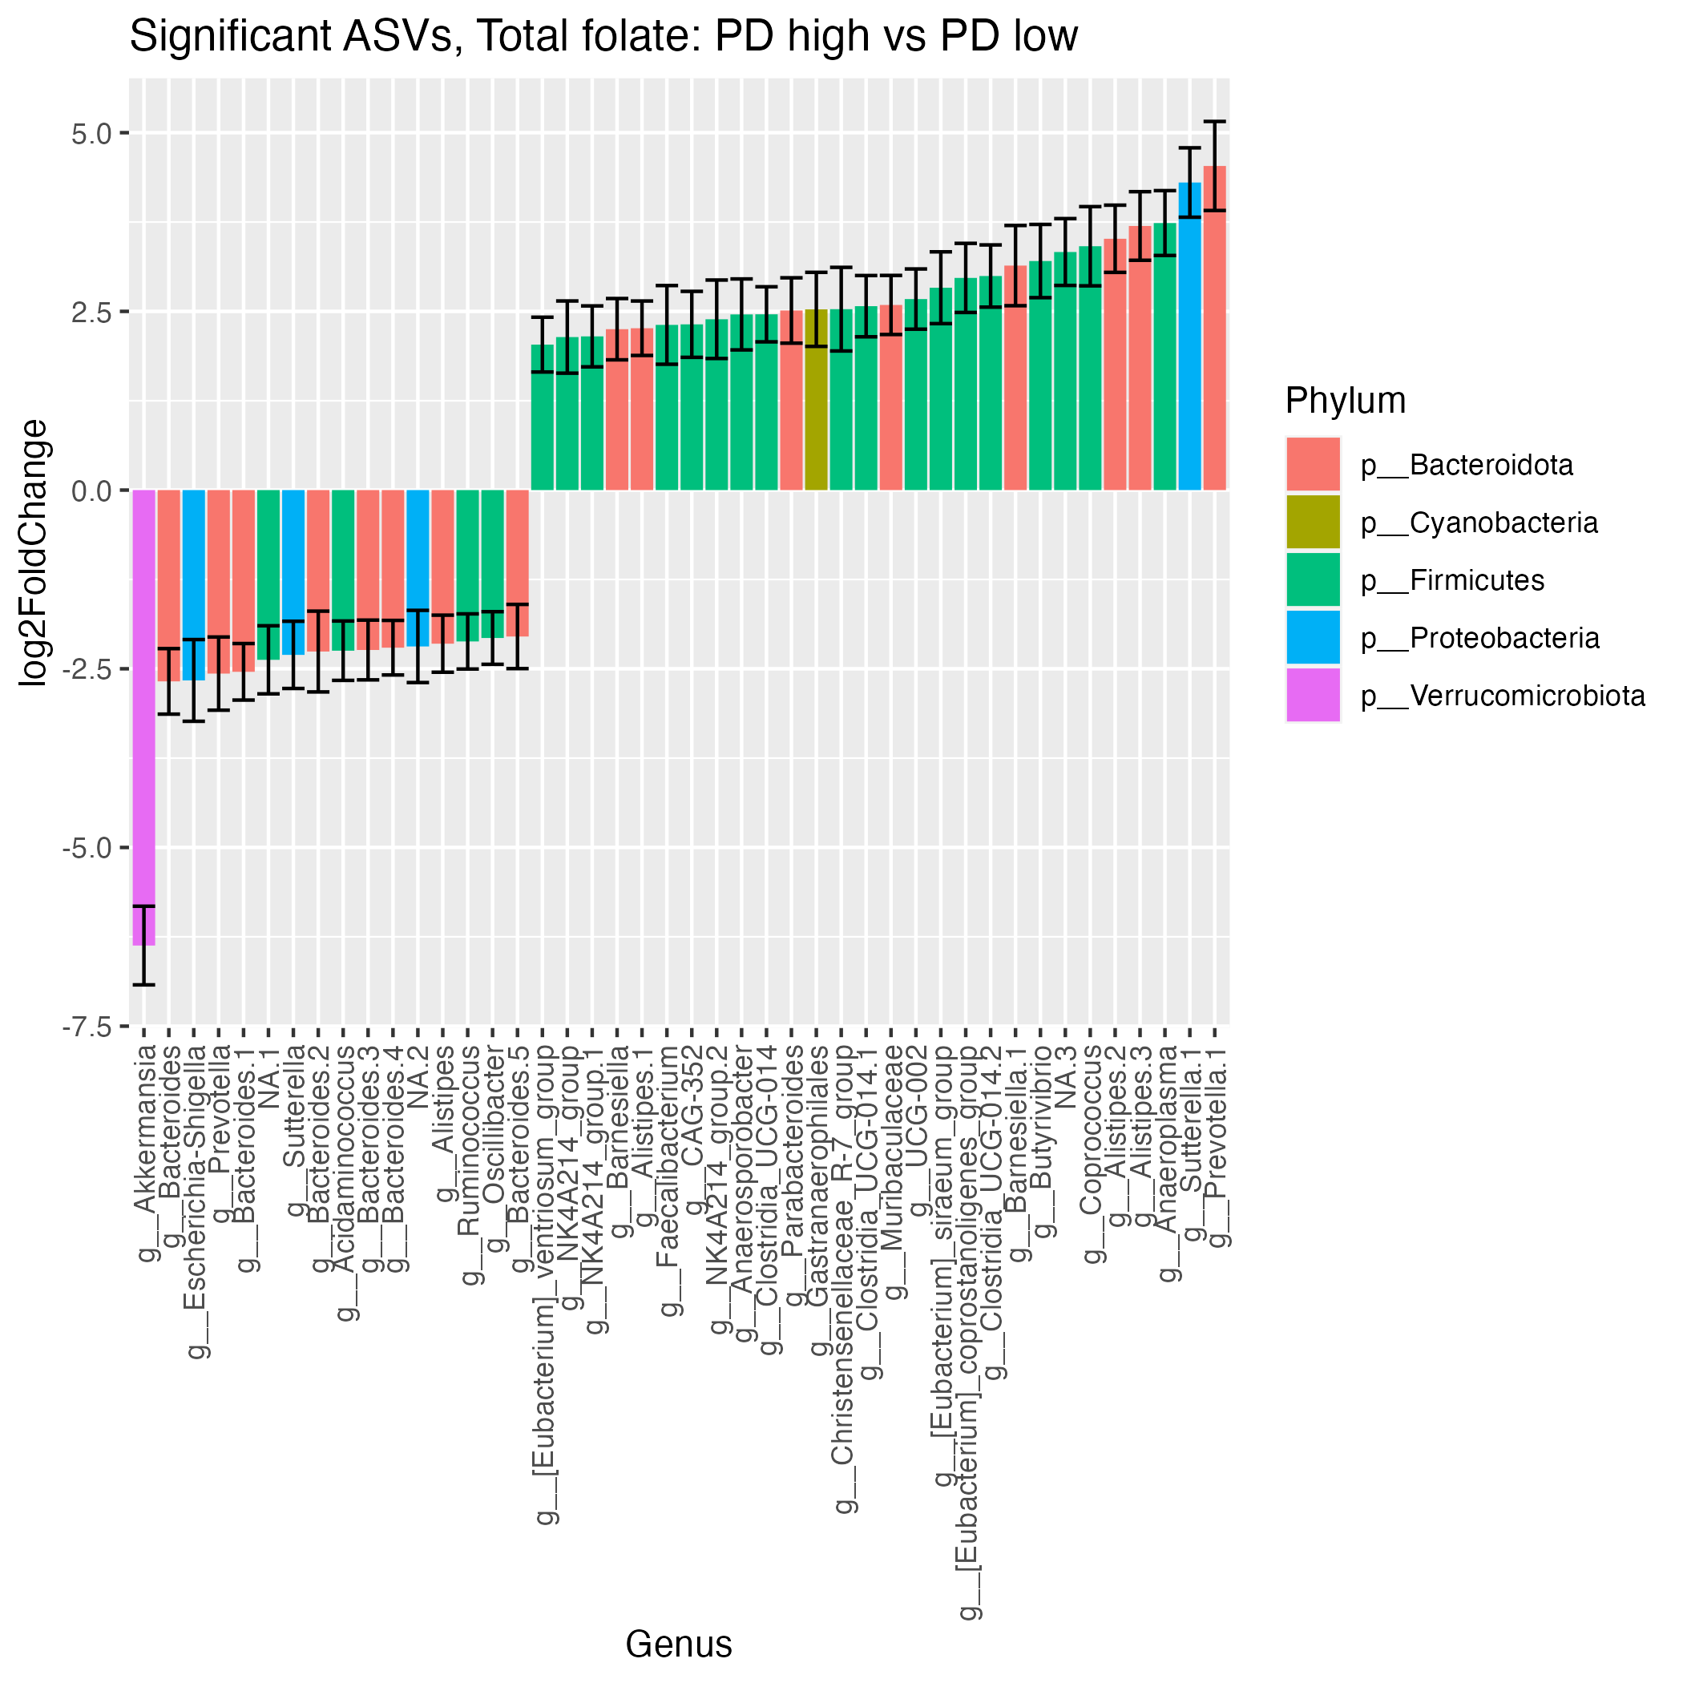
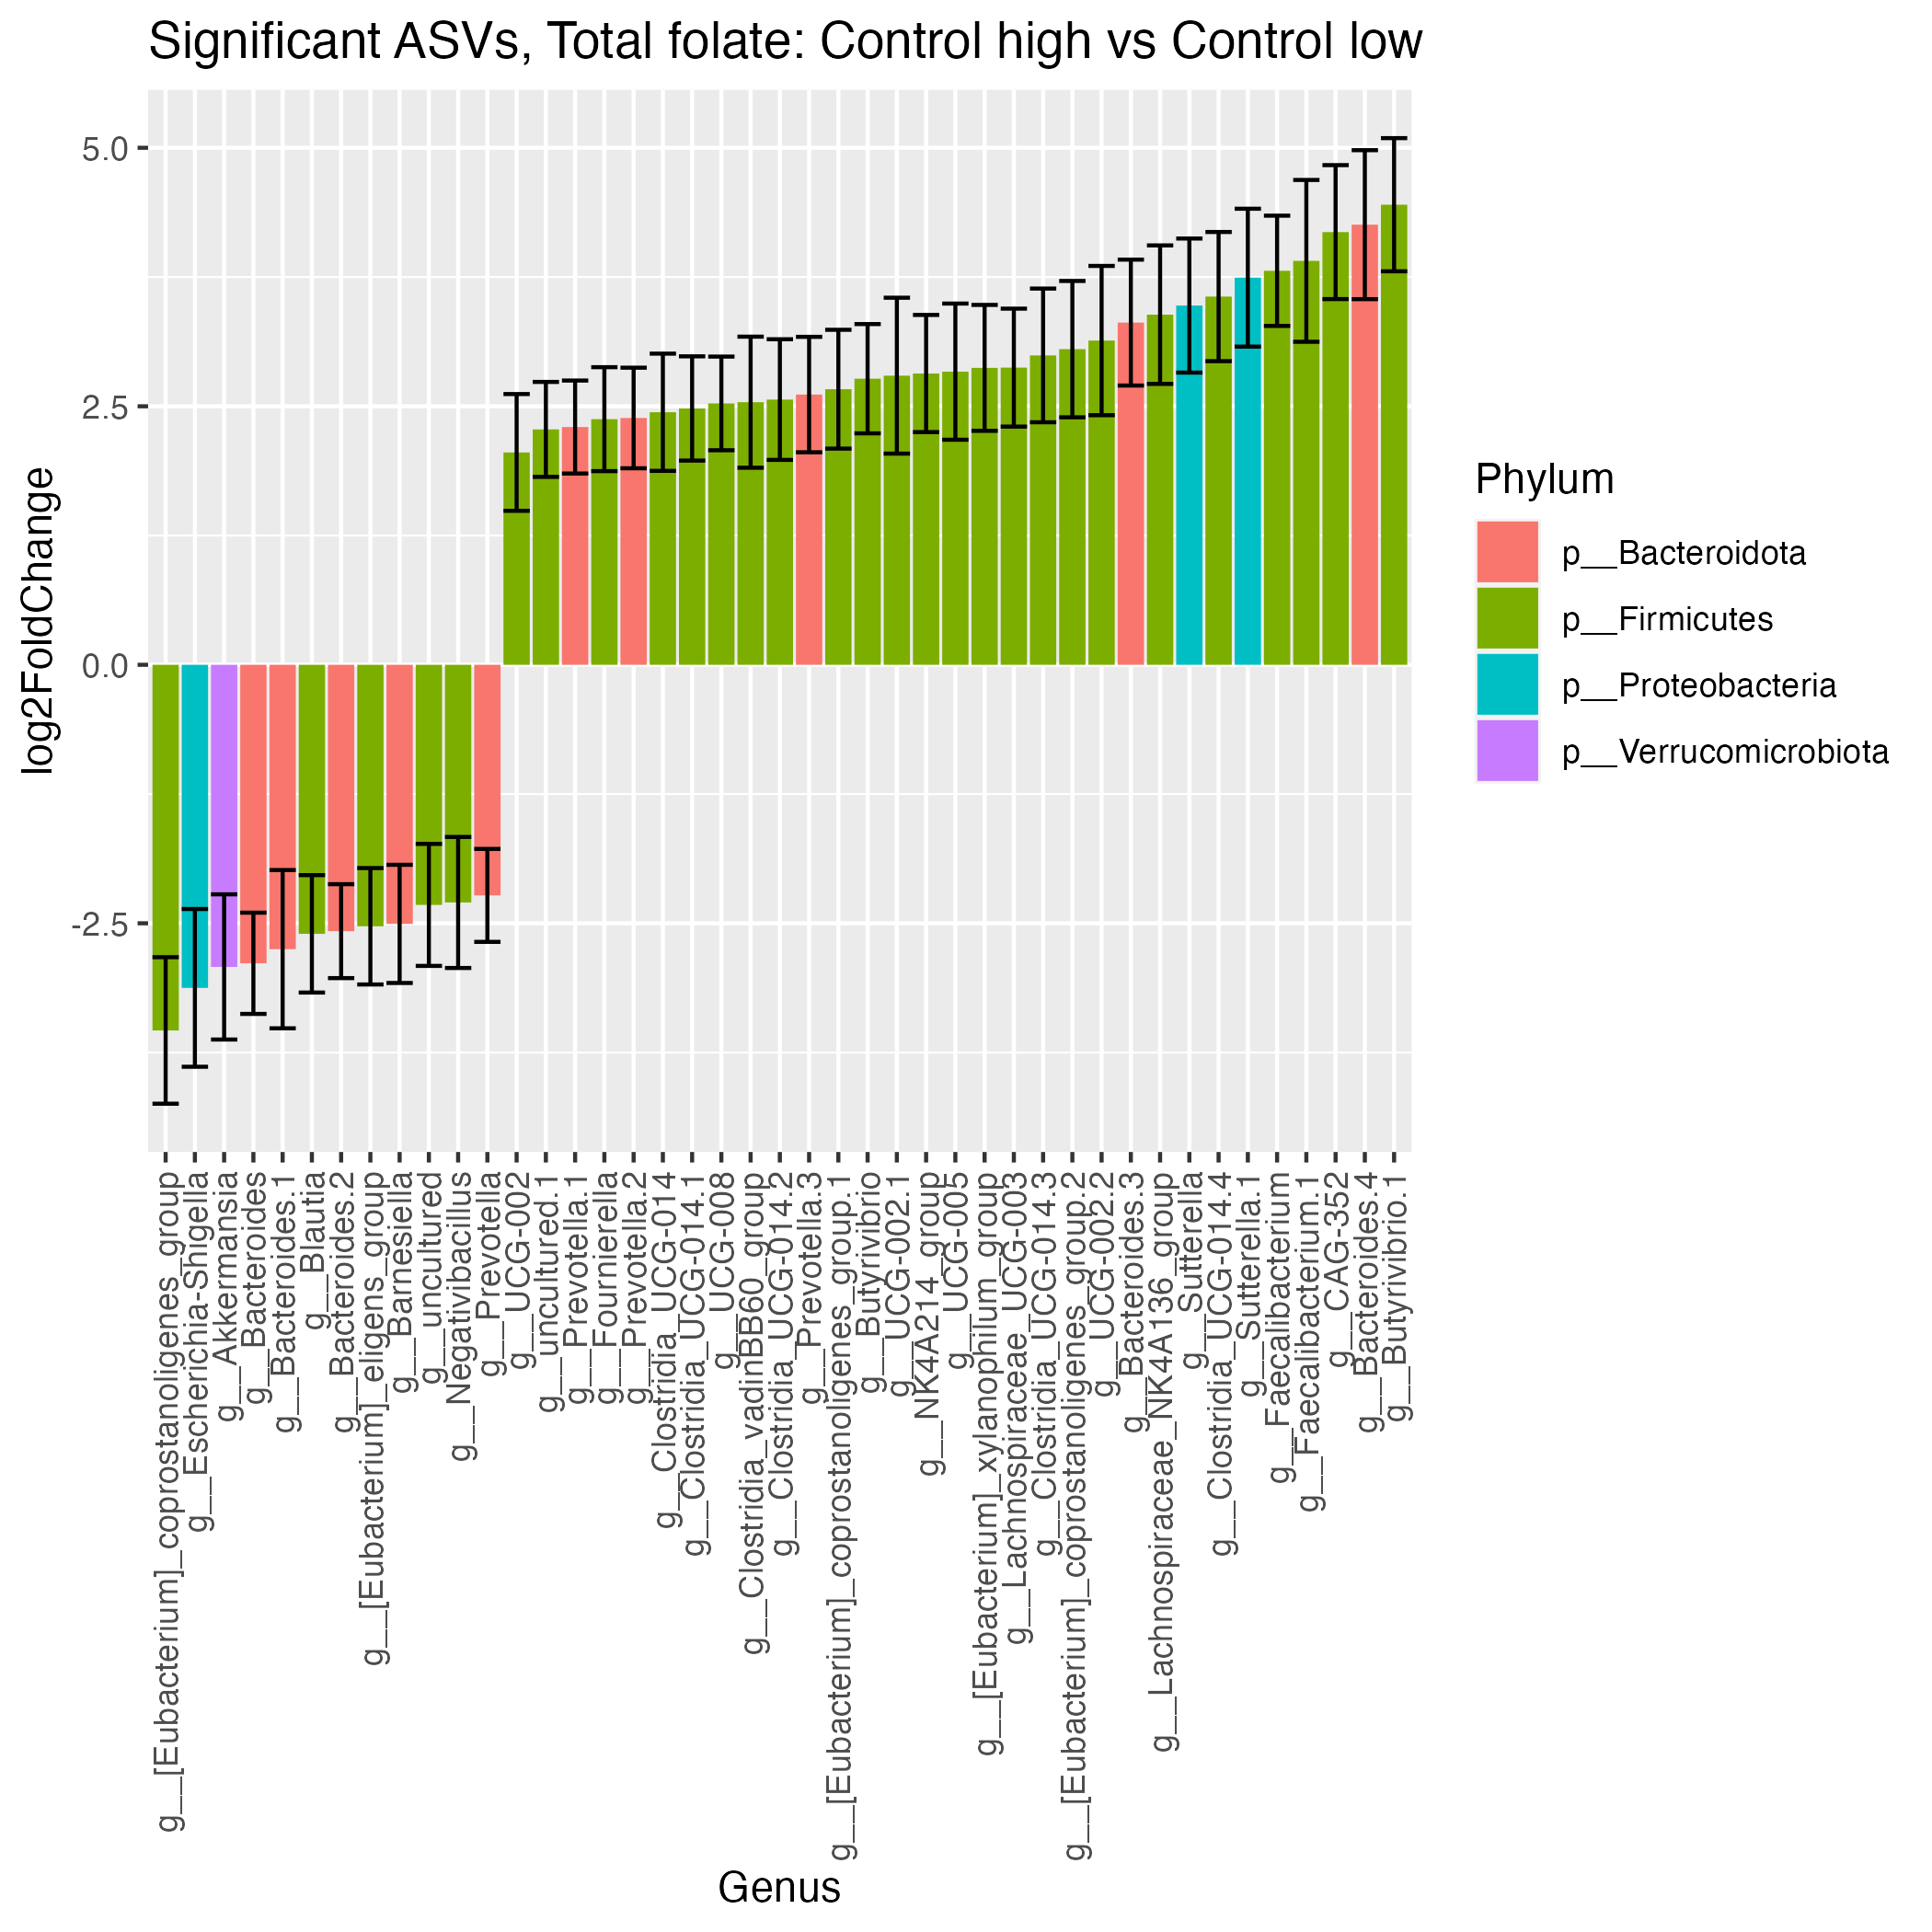
Folate Significant ASVs
16
12
28
31

Slide 10
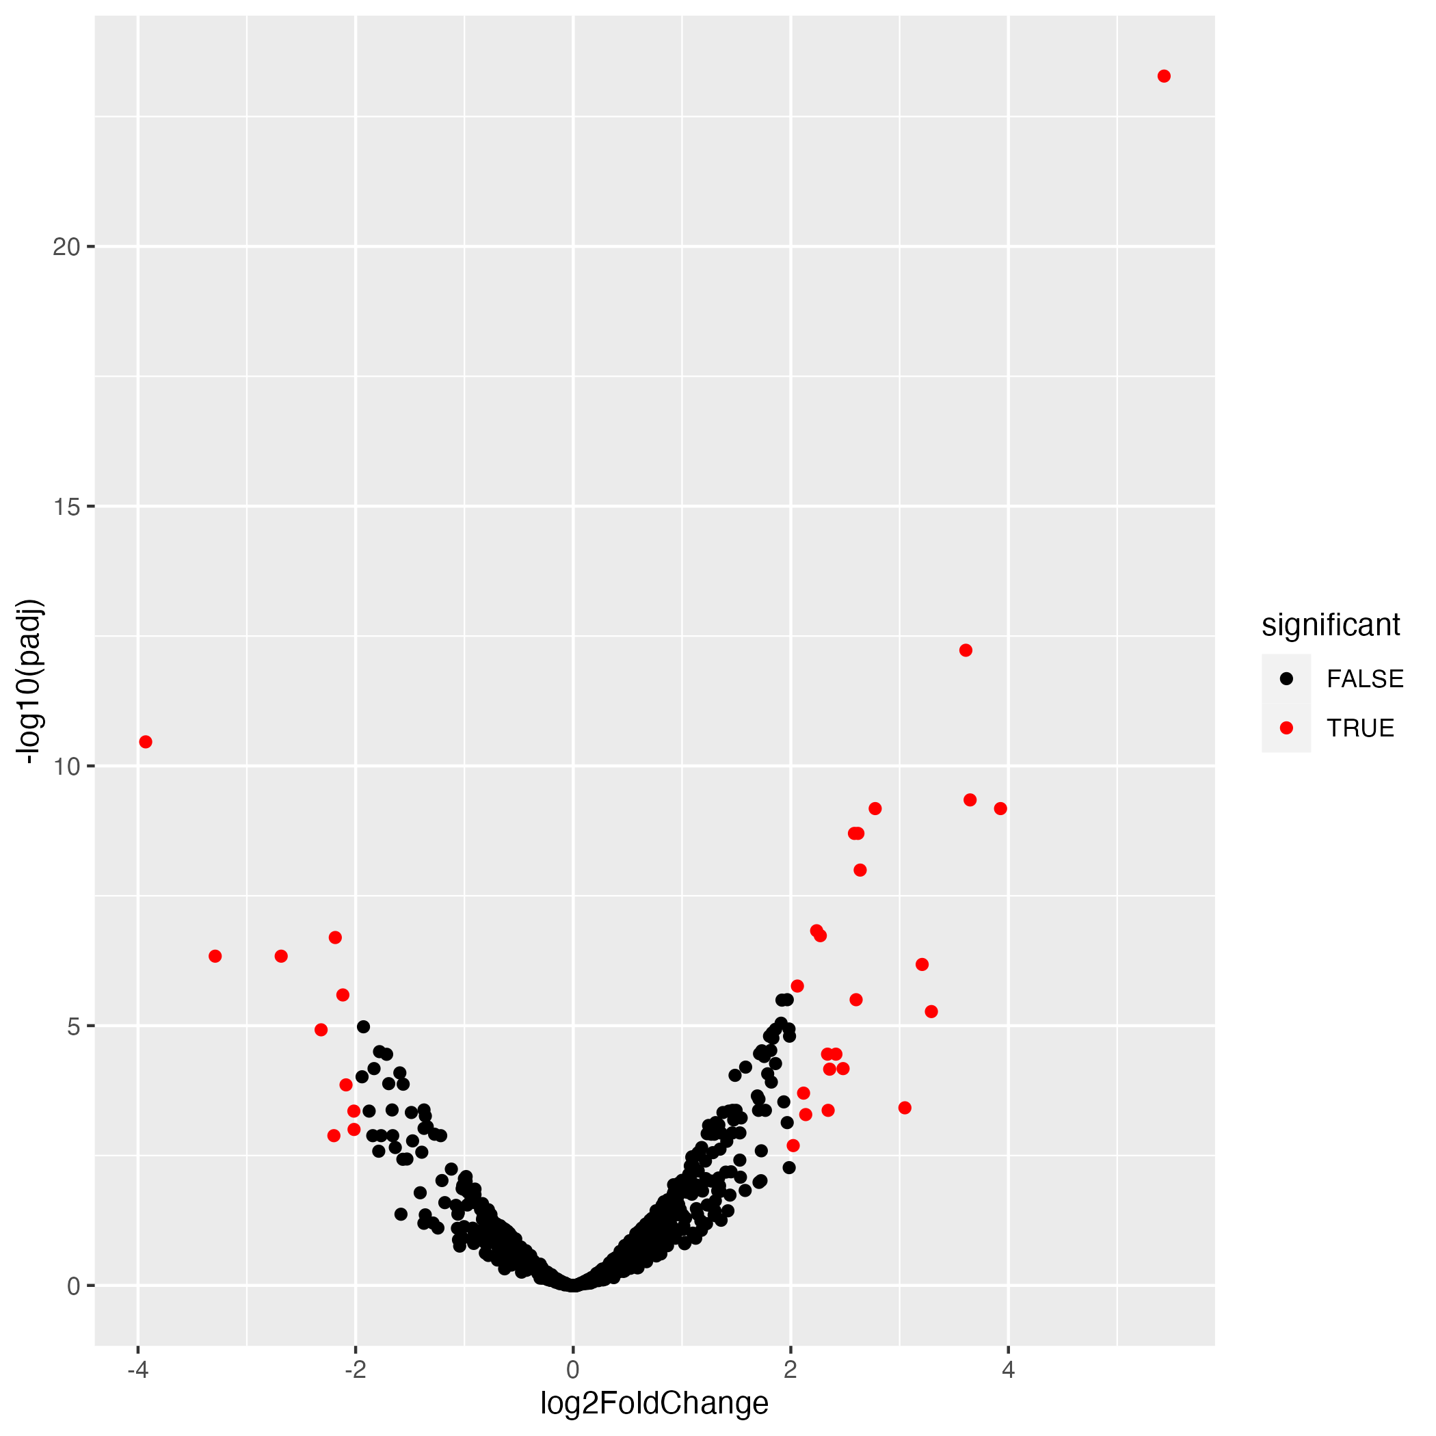
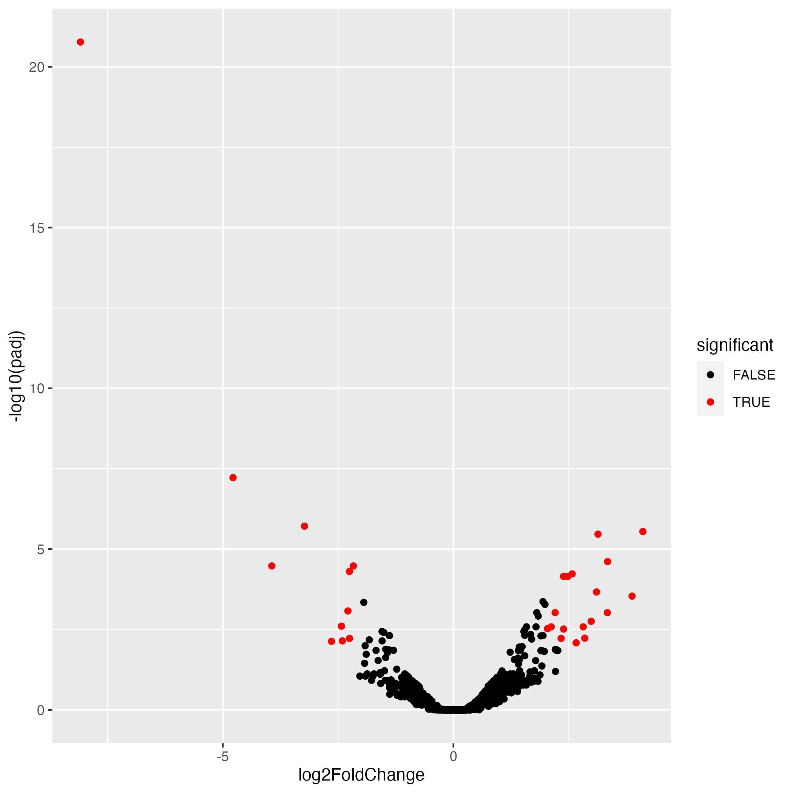
Vitamin C Volcano Plots
PD
Control

Slide 11
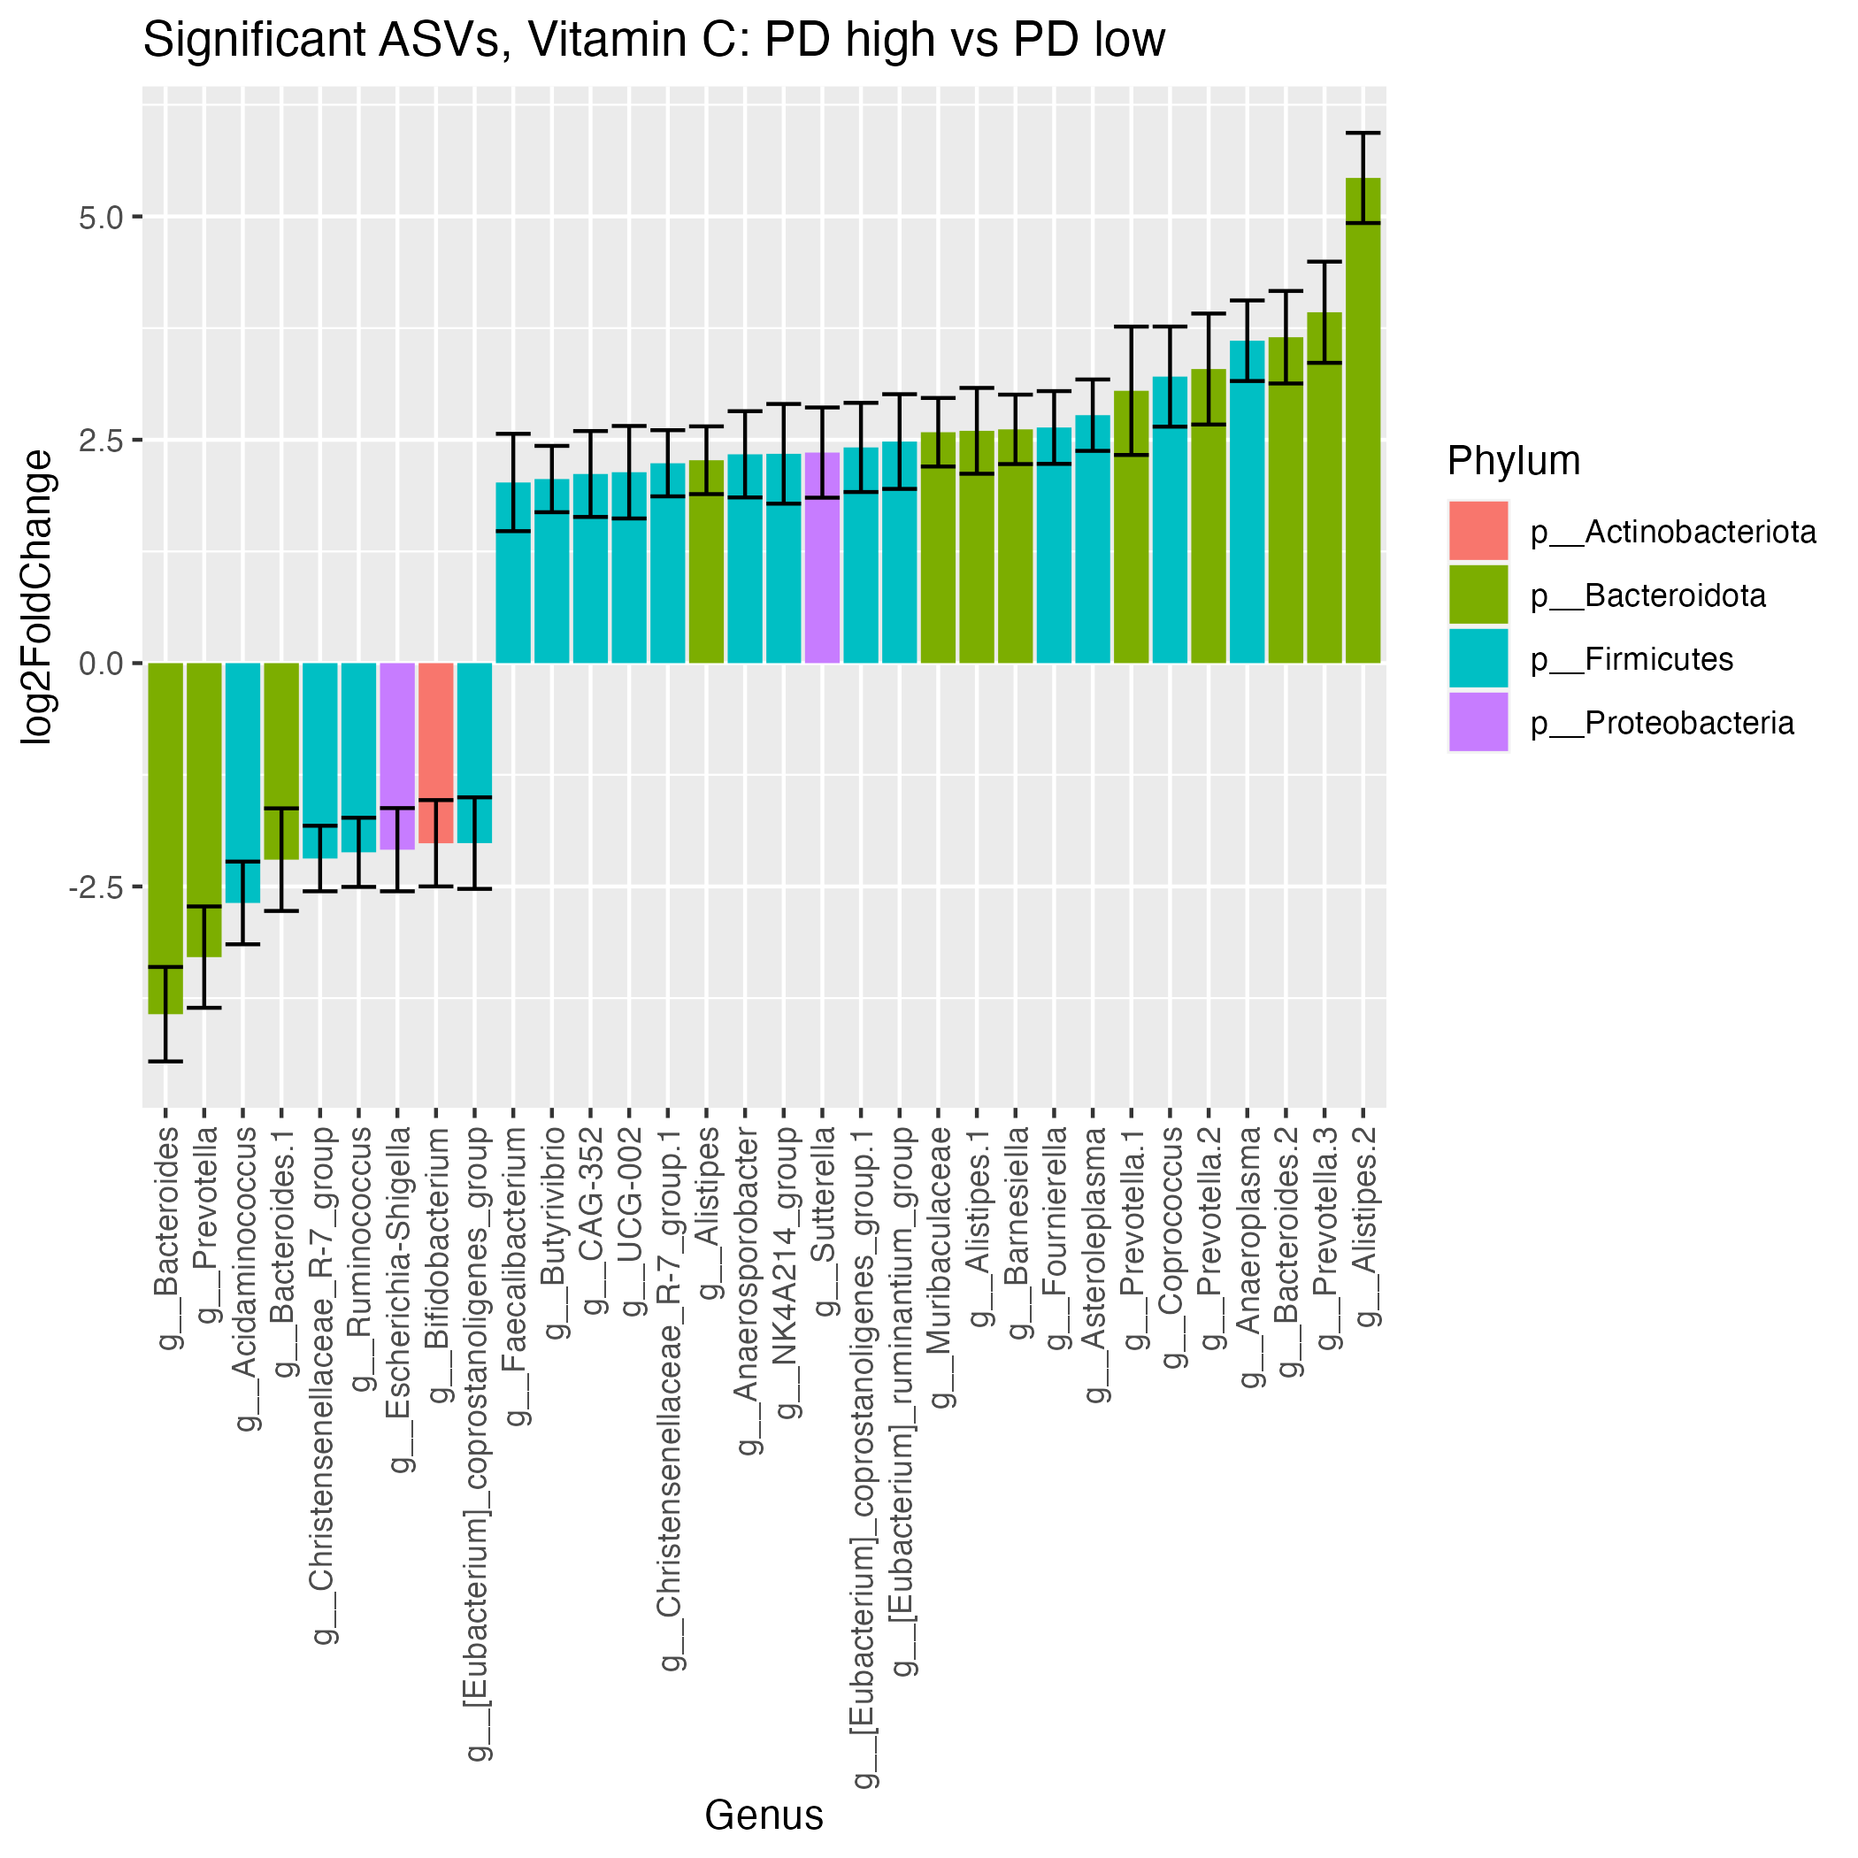
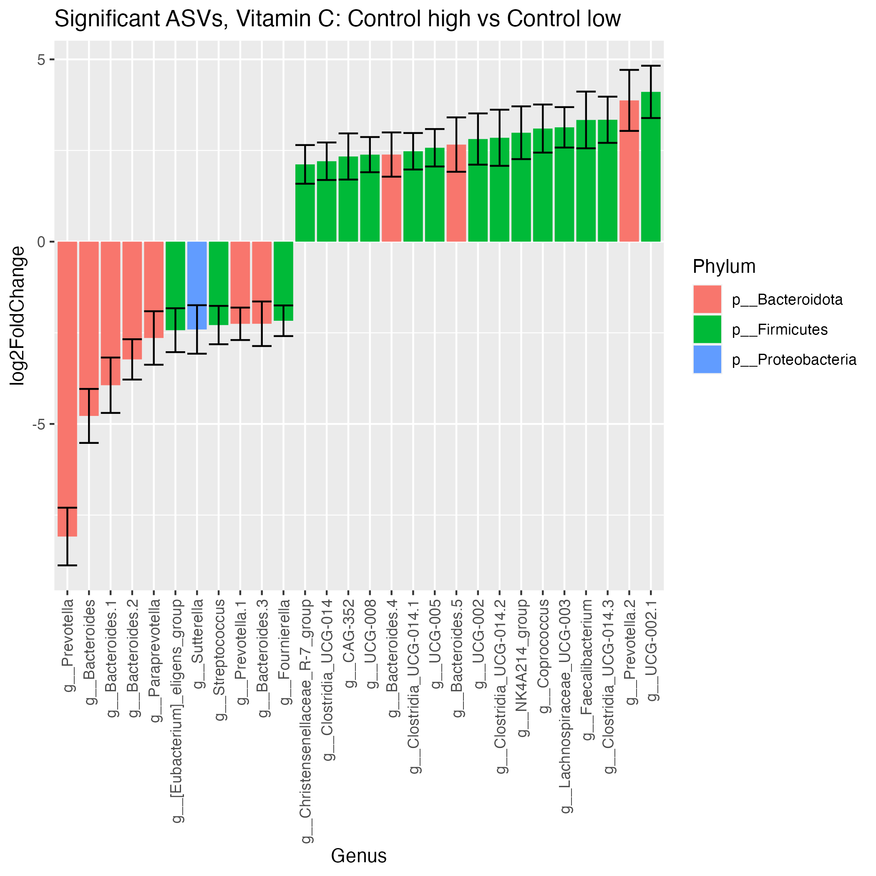
Vitamin C Significant ASVs
12
9
23
31

Slide 12
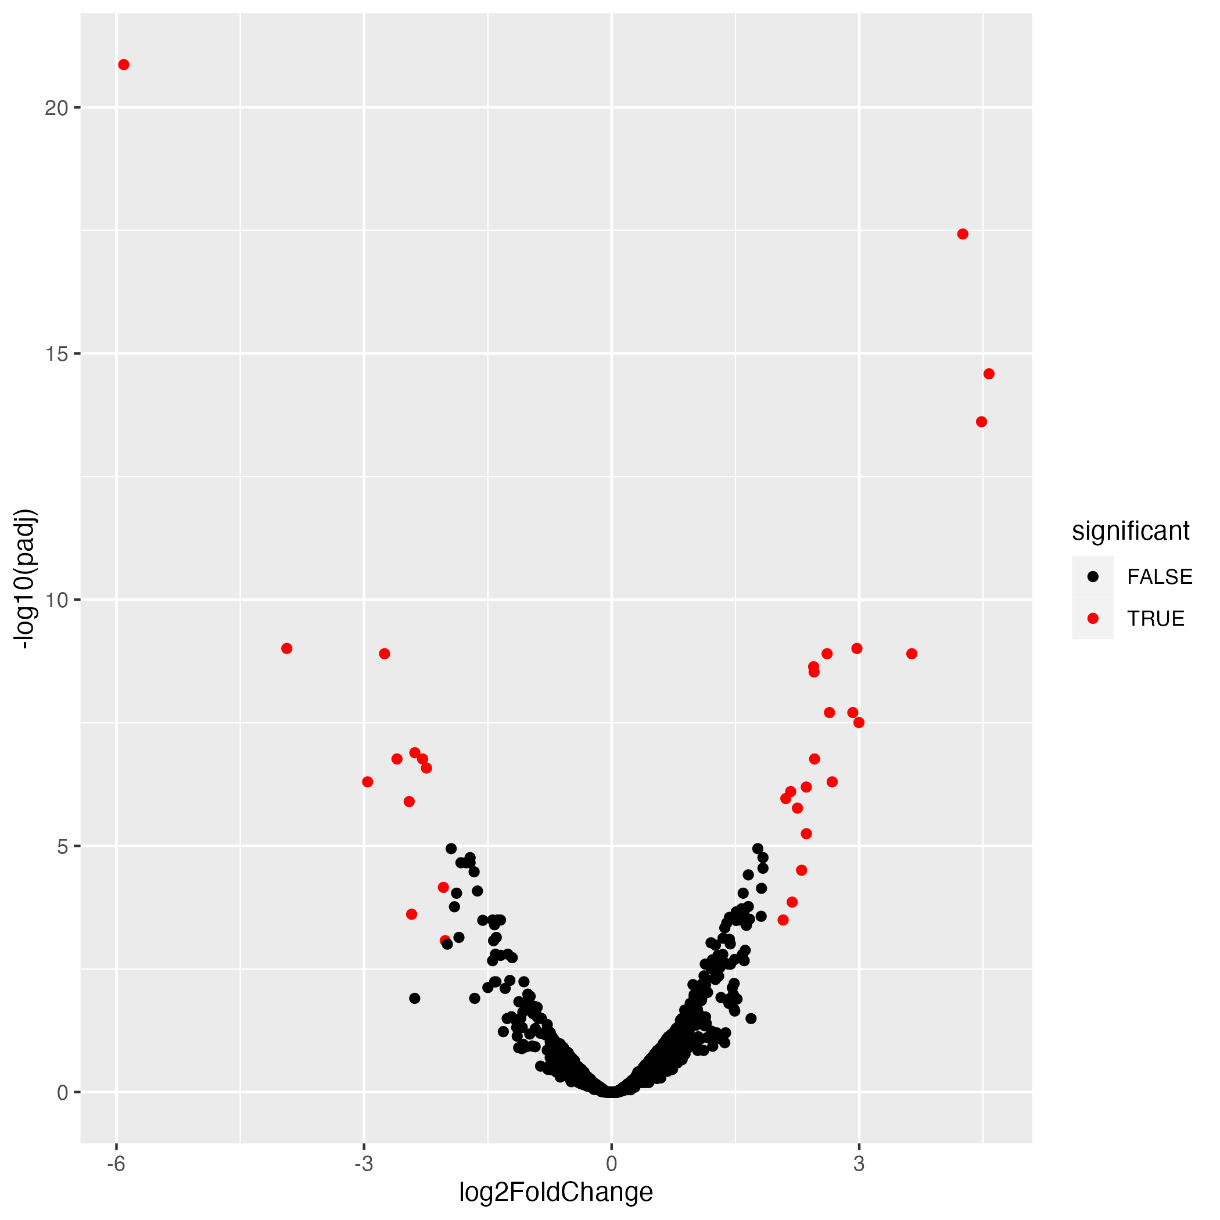
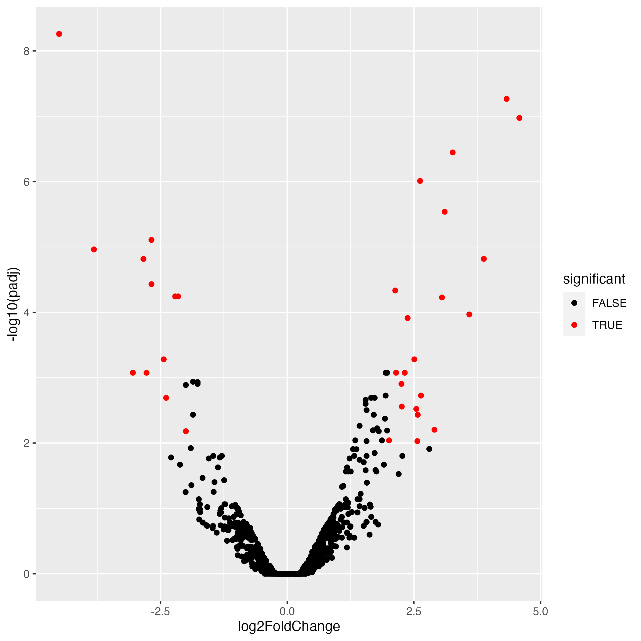
Vitamin B2 Volcano Plots
PD
Control

Slide 13
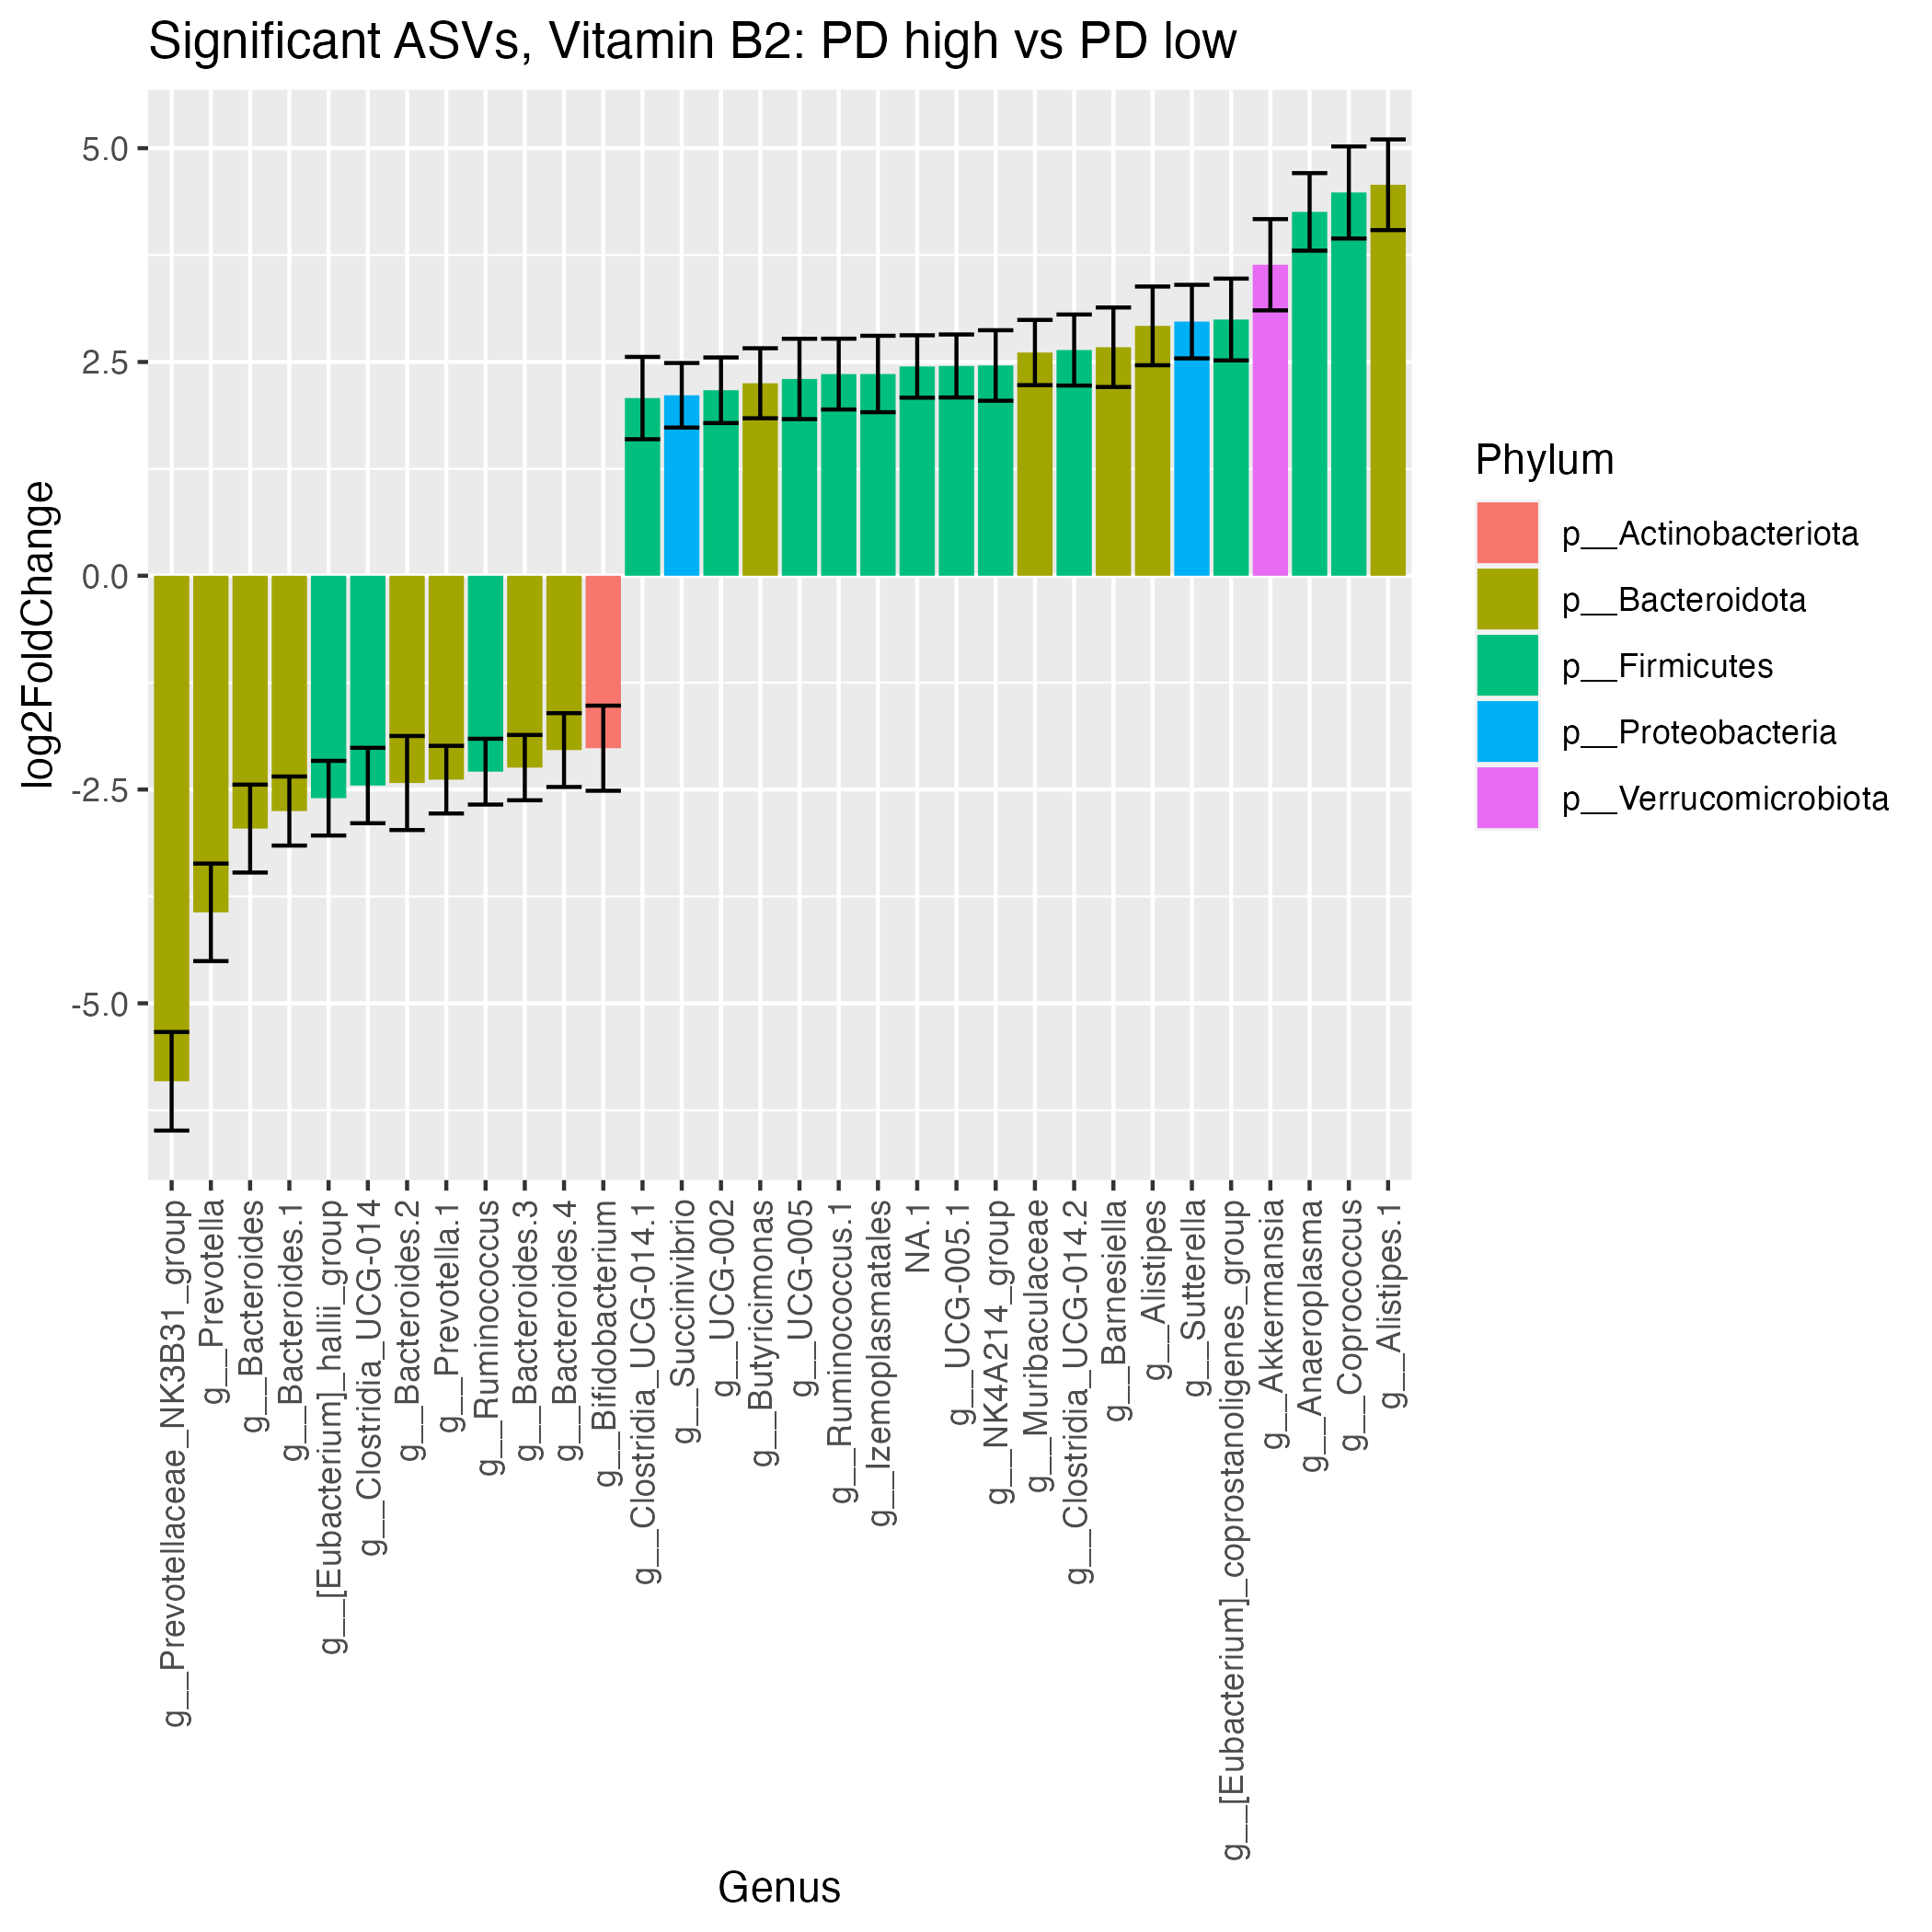
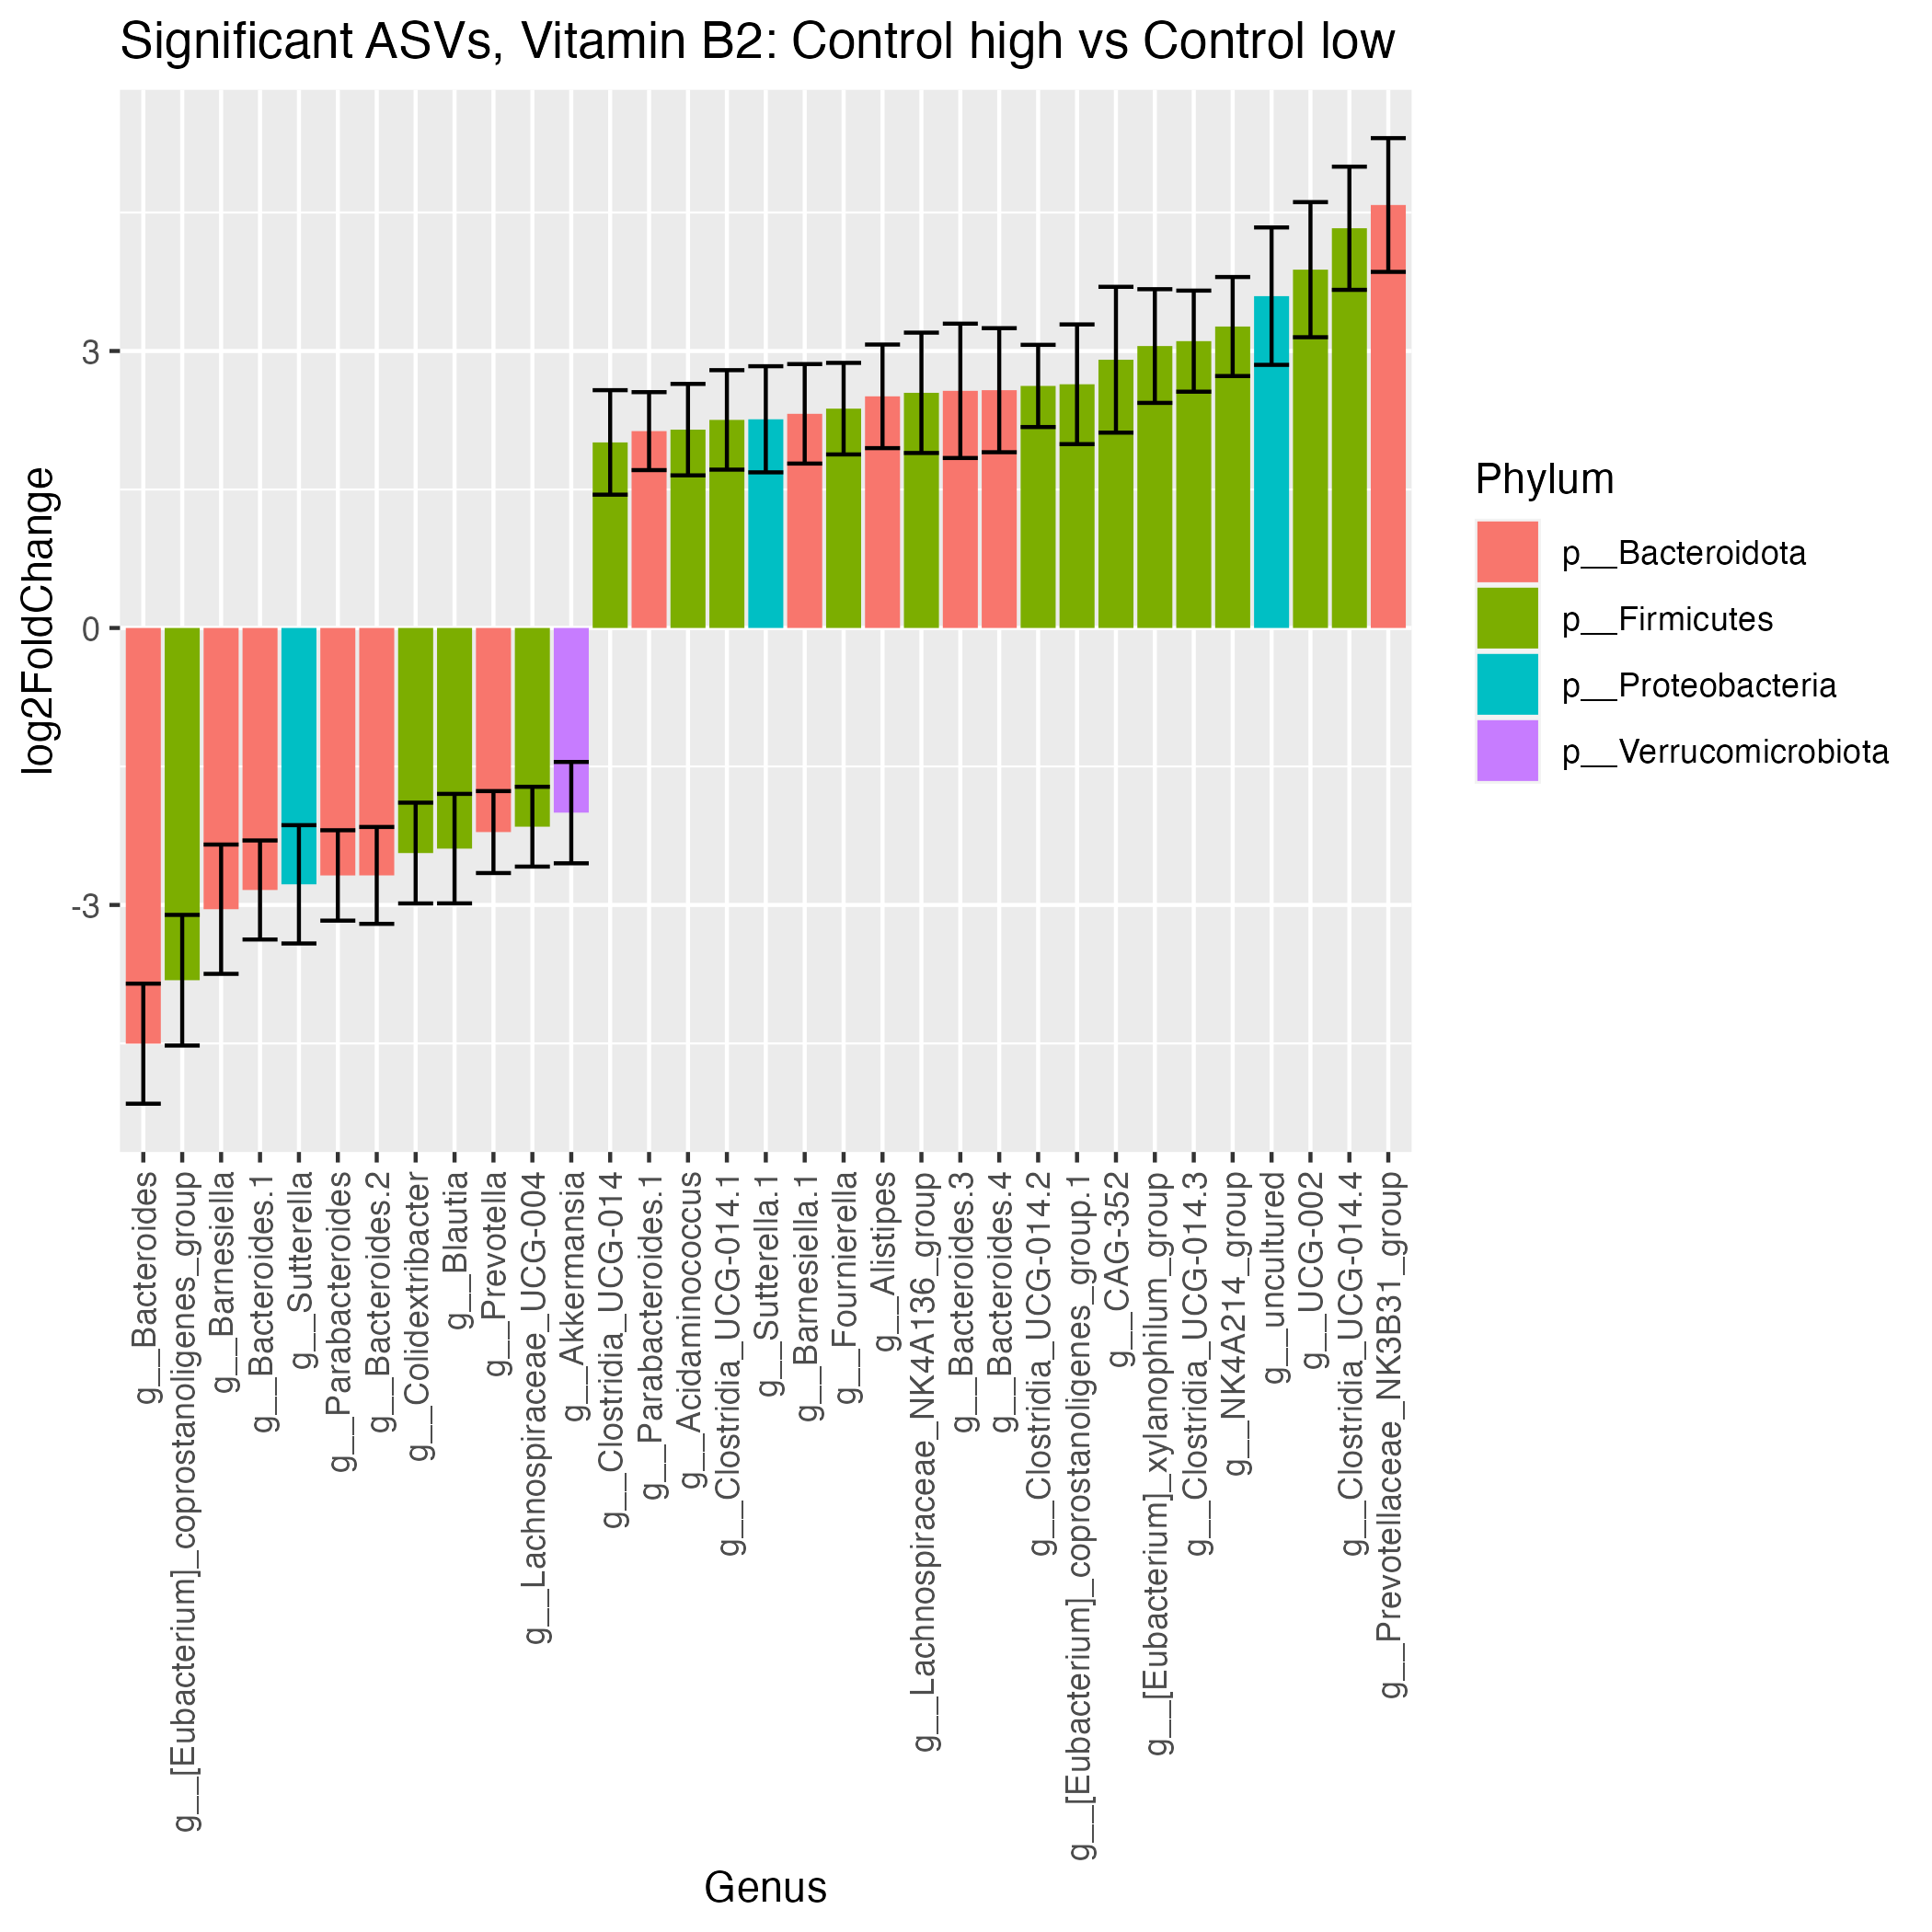
Vitamin B2 Significant ASVs
12
12
20
21

Slide 14
Upregulated and Downregulated ASVs (For Manuscript)
High vs Low | Downregulated ASVs | Upregulated ASVs
Coffee PD | 18 | 9
Coffee Control | 9 | 18
Fructose PD | 13 | 31
Fructose Control | 13 | 21
NSP PD | 14 | 37
NSP Control | 23 | 21
Folate PD | 16 | 28
Folate Control | 12 | 31
Vitamin B2 PD | 9 | 23
Vitamin B2 Control | 12 | 31
Vitamin C PD | 12 | 20
Vitamin C Control | 12 | 21
** low groups are set as reference

Slide 15
Upregulated and Downregulated ASVs for pres
PD High vs Low | Downregulated ASVs | Upregulated ASVs
Coffee | 18 | 9
Fructose | 13 | 31
NSP | 14 | 37
Folate | 16 | 28
Vitamin B2 | 9 | 23
Vitamin C | 12 | 20
Control High vs Low | Downregulated ASVs | Upregulated ASVs
Coffee | 9 | 18
Fructose | 13 | 21
NSP | 23 | 21
Folate | 12 | 31
Vitamin B2 | 12 | 31
Vitamin C | 12 | 21
** low groups are set as reference

Slide 16
Top 3 - 5 Upregulated and Downregulated Genera and Species
High vs Low | Downregulated Genera PD | Upregulted Genera PD | Downregulated Genera Control | Upregulted Genera Control
Coffee | Prevotella, Bacterioides uniformis, Catenibacterium, Barnesiella | Parabacteroides, Muribaculaceae, Bacteriodes intestinalis | Bacteroides, Barnesiella | Bacteroides, Clostridia UCG-014
Folate | Akkermansia, Bacteroides, Escherichia-Shigella | Alistipes, Anaeroplasma, Sutterella, Prevotella | Akkermansia, Bacteroides, Escherichia-Shigella | Faecalibacterium, Bacteroides, Butrvibrio
Fructose | Ruminococcus, Akkermansia, Bacteriodes uniformis, Bacteroides vulgatus | Clostridia UCG-014, Anaeroplasma, Prevotella | Prevotella, Sutterella, Bacteroides stercoris | Clostridia UCG-014, Desulfovibrio, Clostridia vadinBB60
NSP | Akkermansia, Bifidobacterium, Bacteroides, Escherichia-Shigella | Alistipes, Prevotella, Clostridia UCG-014 | Gastranaerophilales, Streptococcus, Bacteroides stercoris | Bacteroides, Sutterella, Butyrivibrio, Prevotella
Vitamin B2 | Prevotella, Bacteroides uniformis, Bacteroides coprophilus, | Akkermansia, Anaeroplasma, Coprococcus, Alistipes | Bacteroides vulgatus,Bacteroides stercoris, Barnesiella, Sutterella | Prevotella, Clostridia UCG-014
Vitamin C | Prevotella, Bacteroides plebeius, Acidaminococcus | Prevotella, Alistipes, Bacteriodes, Anaeroplasma | Prevotella, Bacteroides plebeius, Bacteroides stercoris, Bacterioides uniformis | Lachnospiraceae, Faecalibacterium, Clostridia UCG-014, Prevotella

Slide 17
Relative Abundance: Genera of Interest Dysregulated in PD:
Bacteroides
Prevotella
Akkermansia
Alistipes

Slide 18
Bacteroides
Mix reports of higher and lower abundance of bacteroides in PD.
Increased abundance in Western Diet.
https://www.ncbi.nlm.nih.gov/pmc/articles/PMC6024871/
https://www.ncbi.nlm.nih.gov/pmc/articles/PMC8398149/
Our Findings:
Generally downregulated in all PD nutrients besides Coffee where it is upregulated.

Slide 19
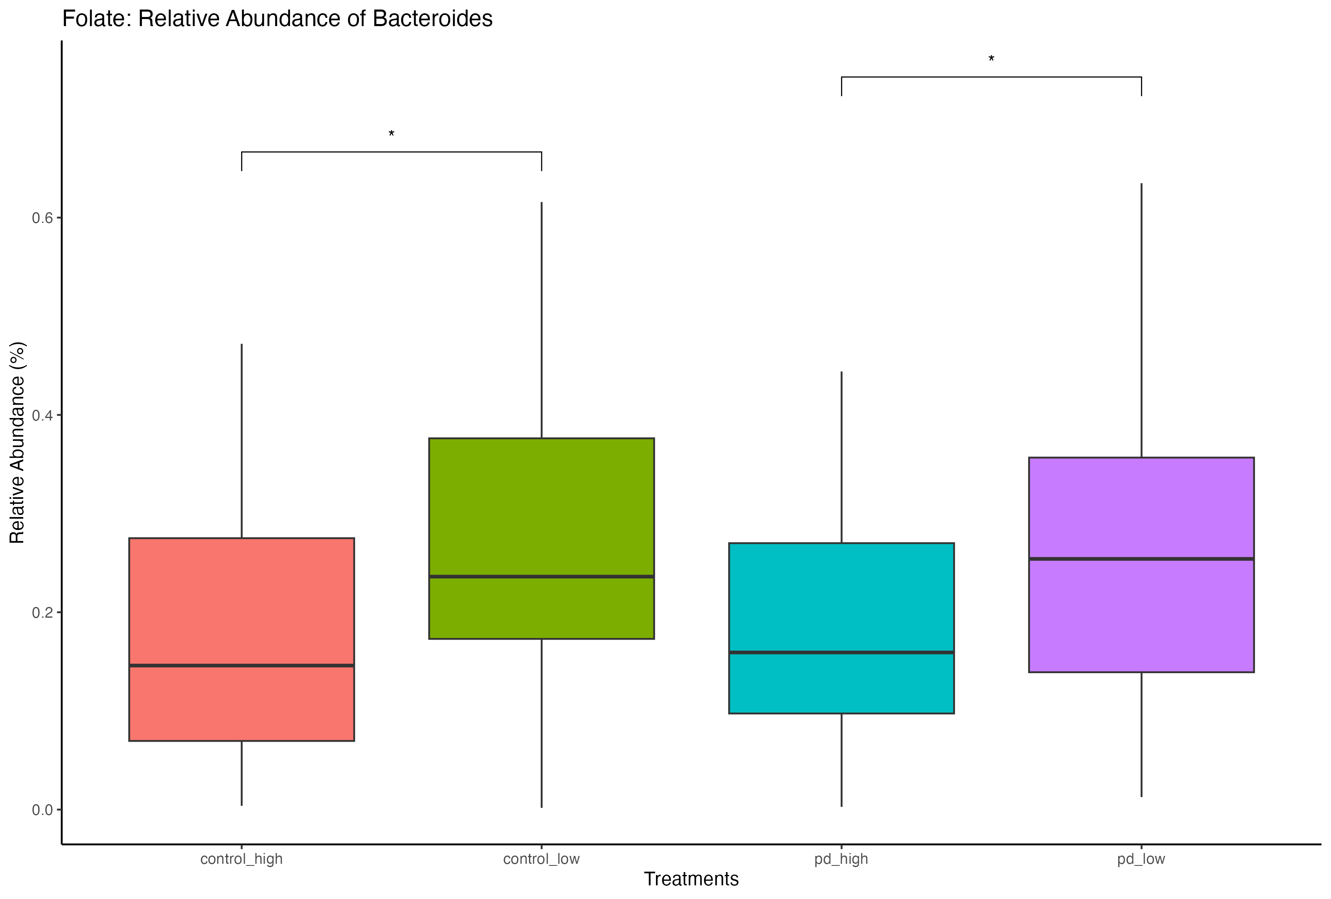
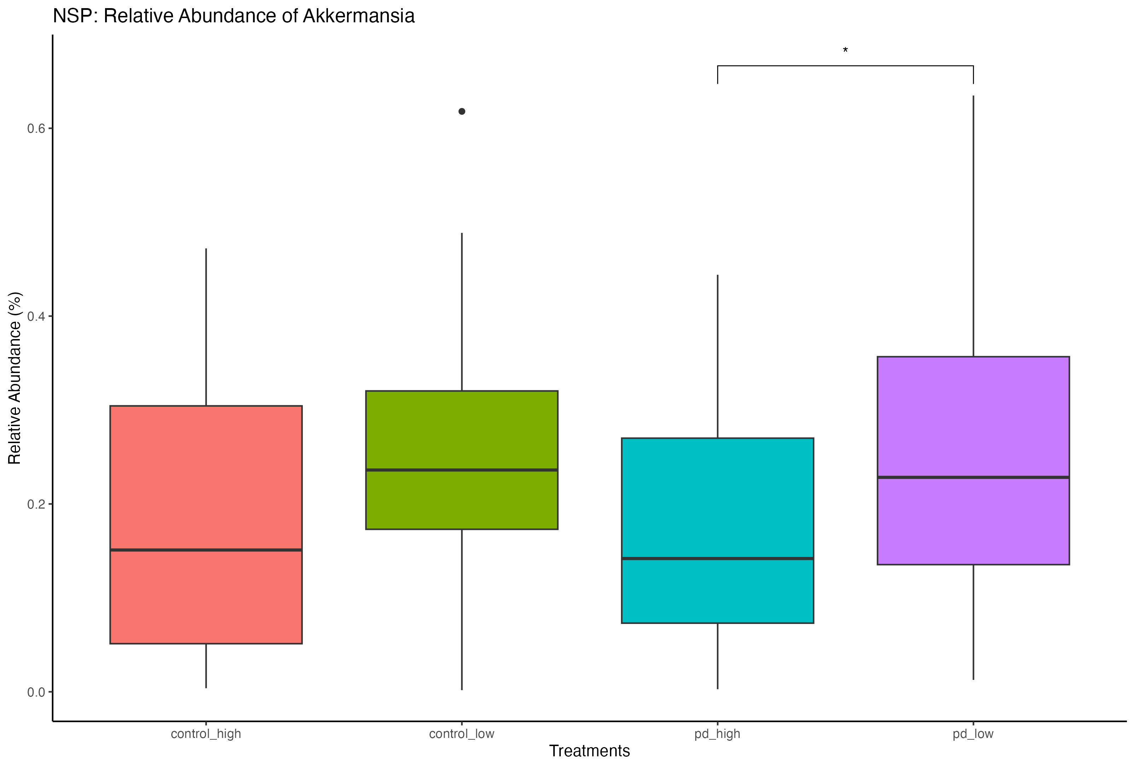
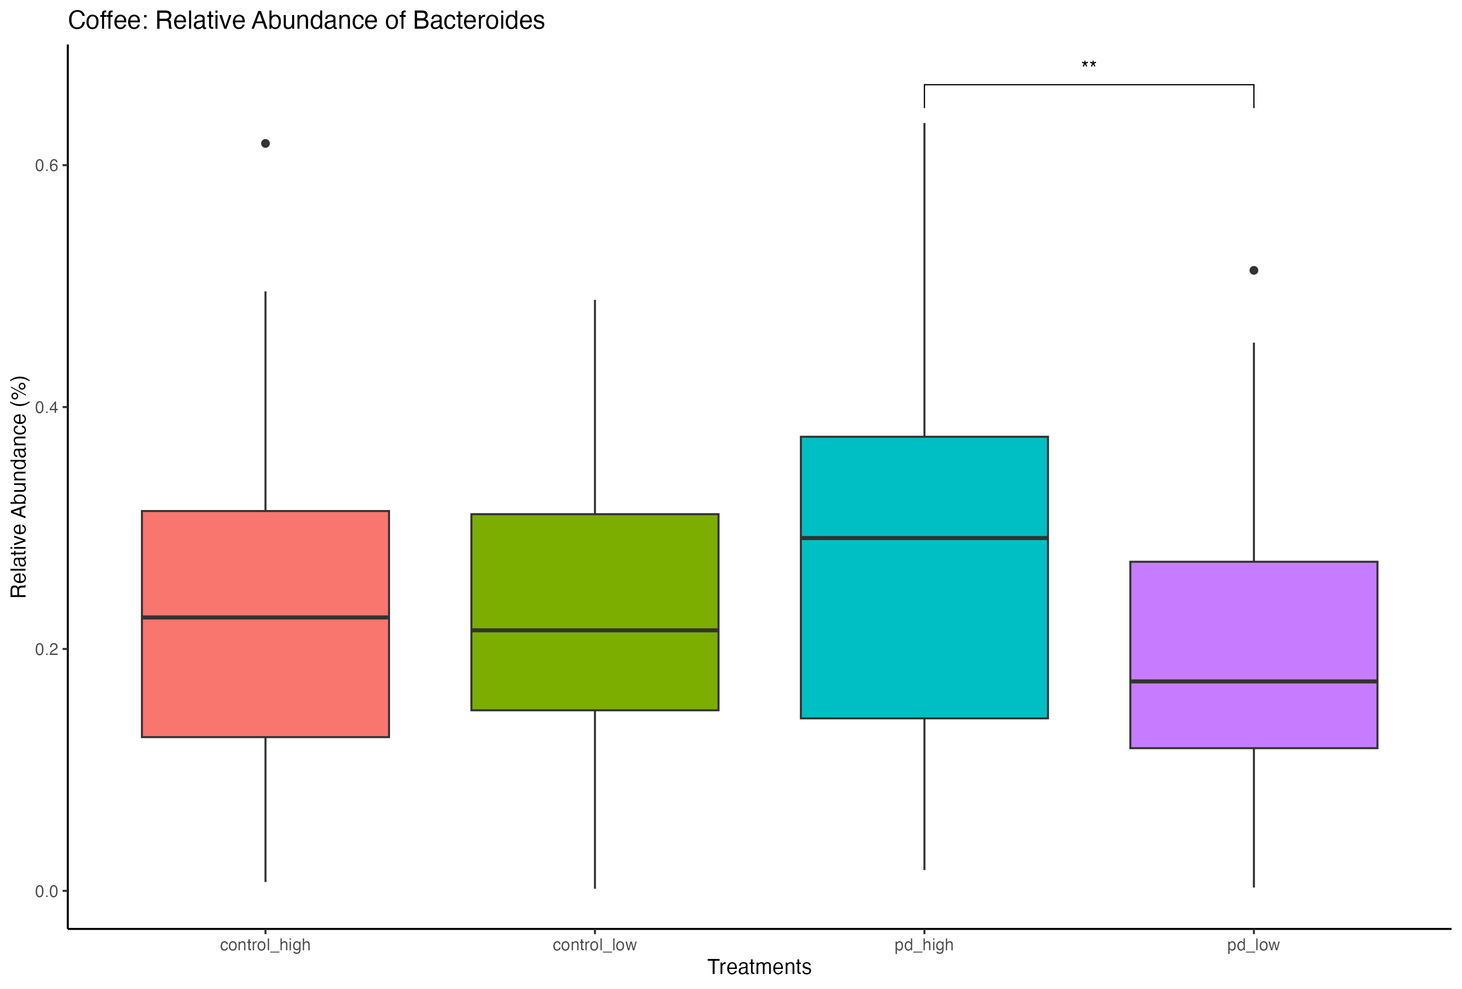
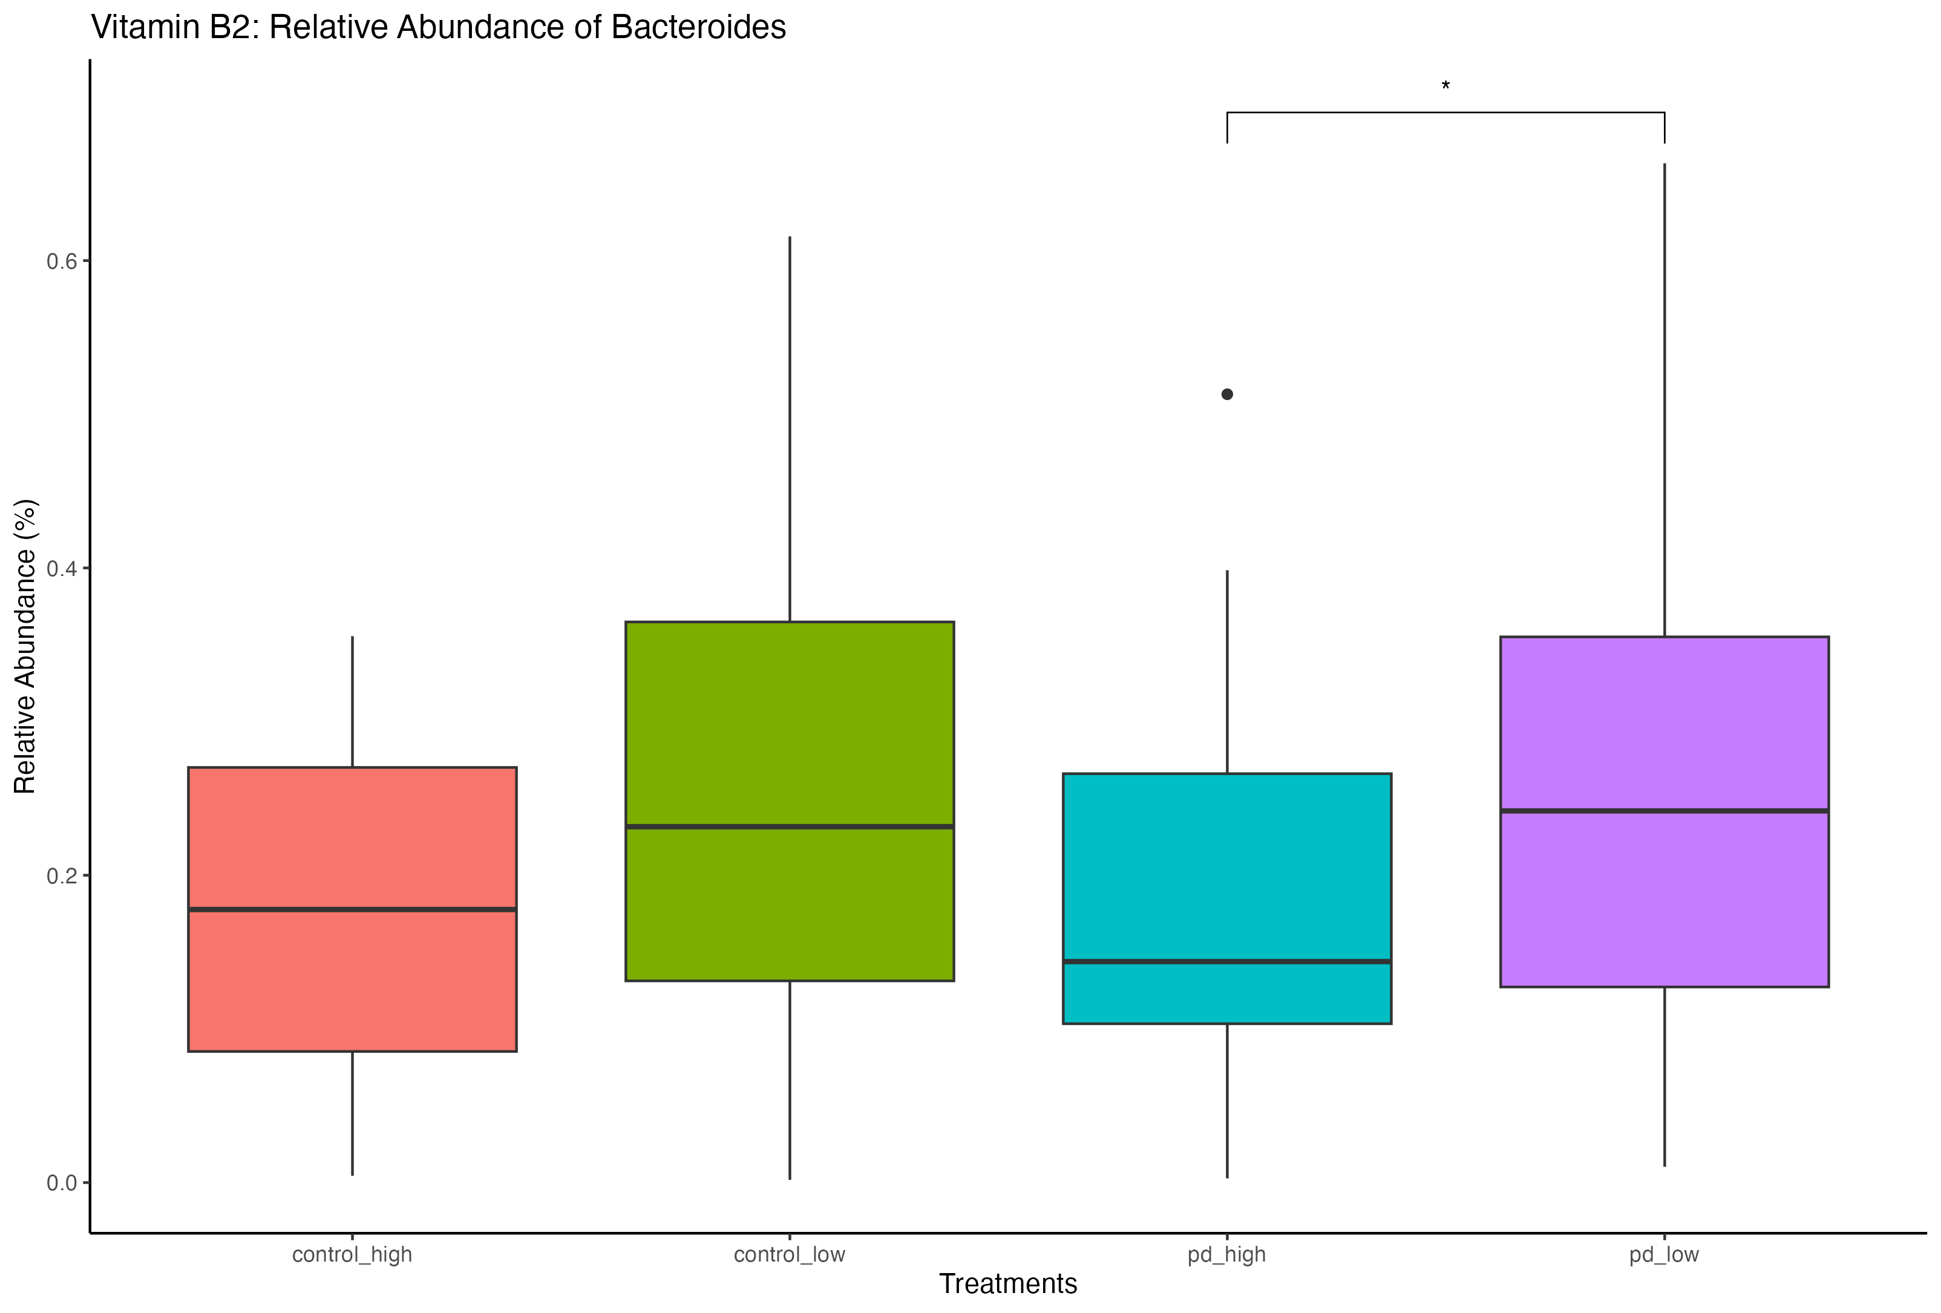
Bacteroides
Relative
Abundance
(Significant Results)
Pairwise Comparisons with Wilcoxon Tests
** p<0.01
* p<0.05

Slide 20
Prevotella
Microbiome studies in PD reveal a decrease in Prevotella in PD vs Healthy controls.
https://www.ncbi.nlm.nih.gov/pmc/articles/PMC6024871/
https://www.ncbi.nlm.nih.gov/pmc/articles/PMC9804059/
Our Findings:
Downregulated in PD Coffee, Vitamin B2, and Vitamin C.
Upregulated in PD NSP, Fructose, and Folate

Slide 21
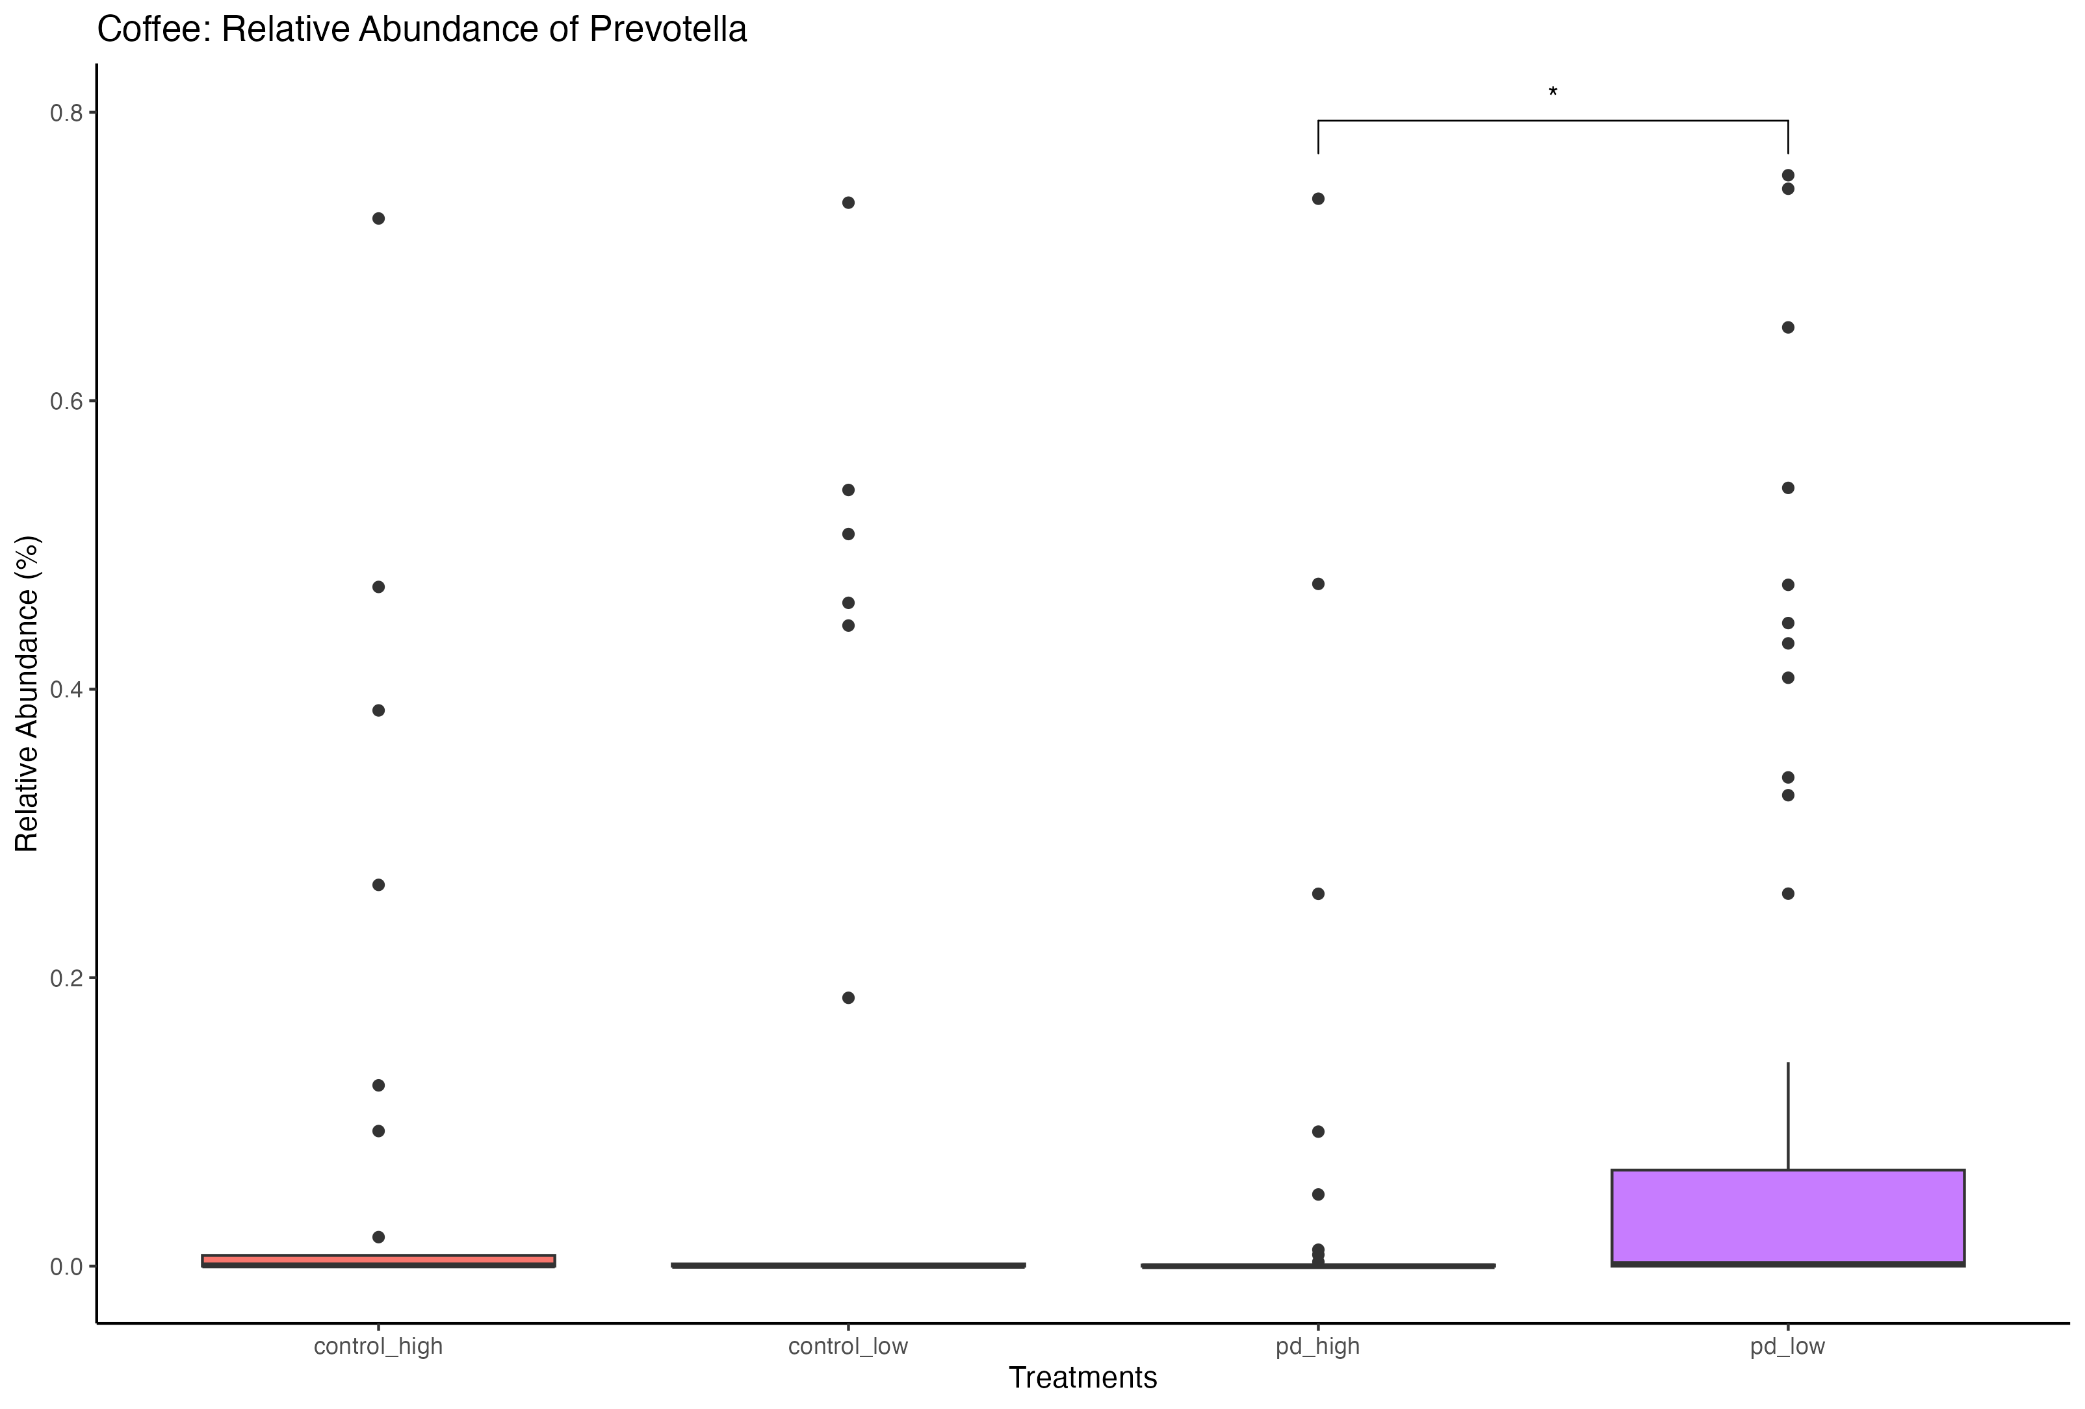
Prevotella Relative Abundance (Significant Results)
Pairwise Comparisons with Wilcoxon Tests
* p<0.05

Slide 22
Akkermansia
Degrades mucin in the GI tract and is negatively associated with metabolic disease, however, it is positively associated with gut-brain axis diseases such as PD.
Akkermansia appears to flourish in individuals that are malnourished and consume low dietary fiber.
https://onlinelibrary.wiley.com/doi/10.1111/ene.15671
Our Findings:
Reduced Akkermansia in PD Folate, NSP, Coffee, and Fructose.
Increased in PD Vitamin B2
No change in PD Vitamin C

Slide 23
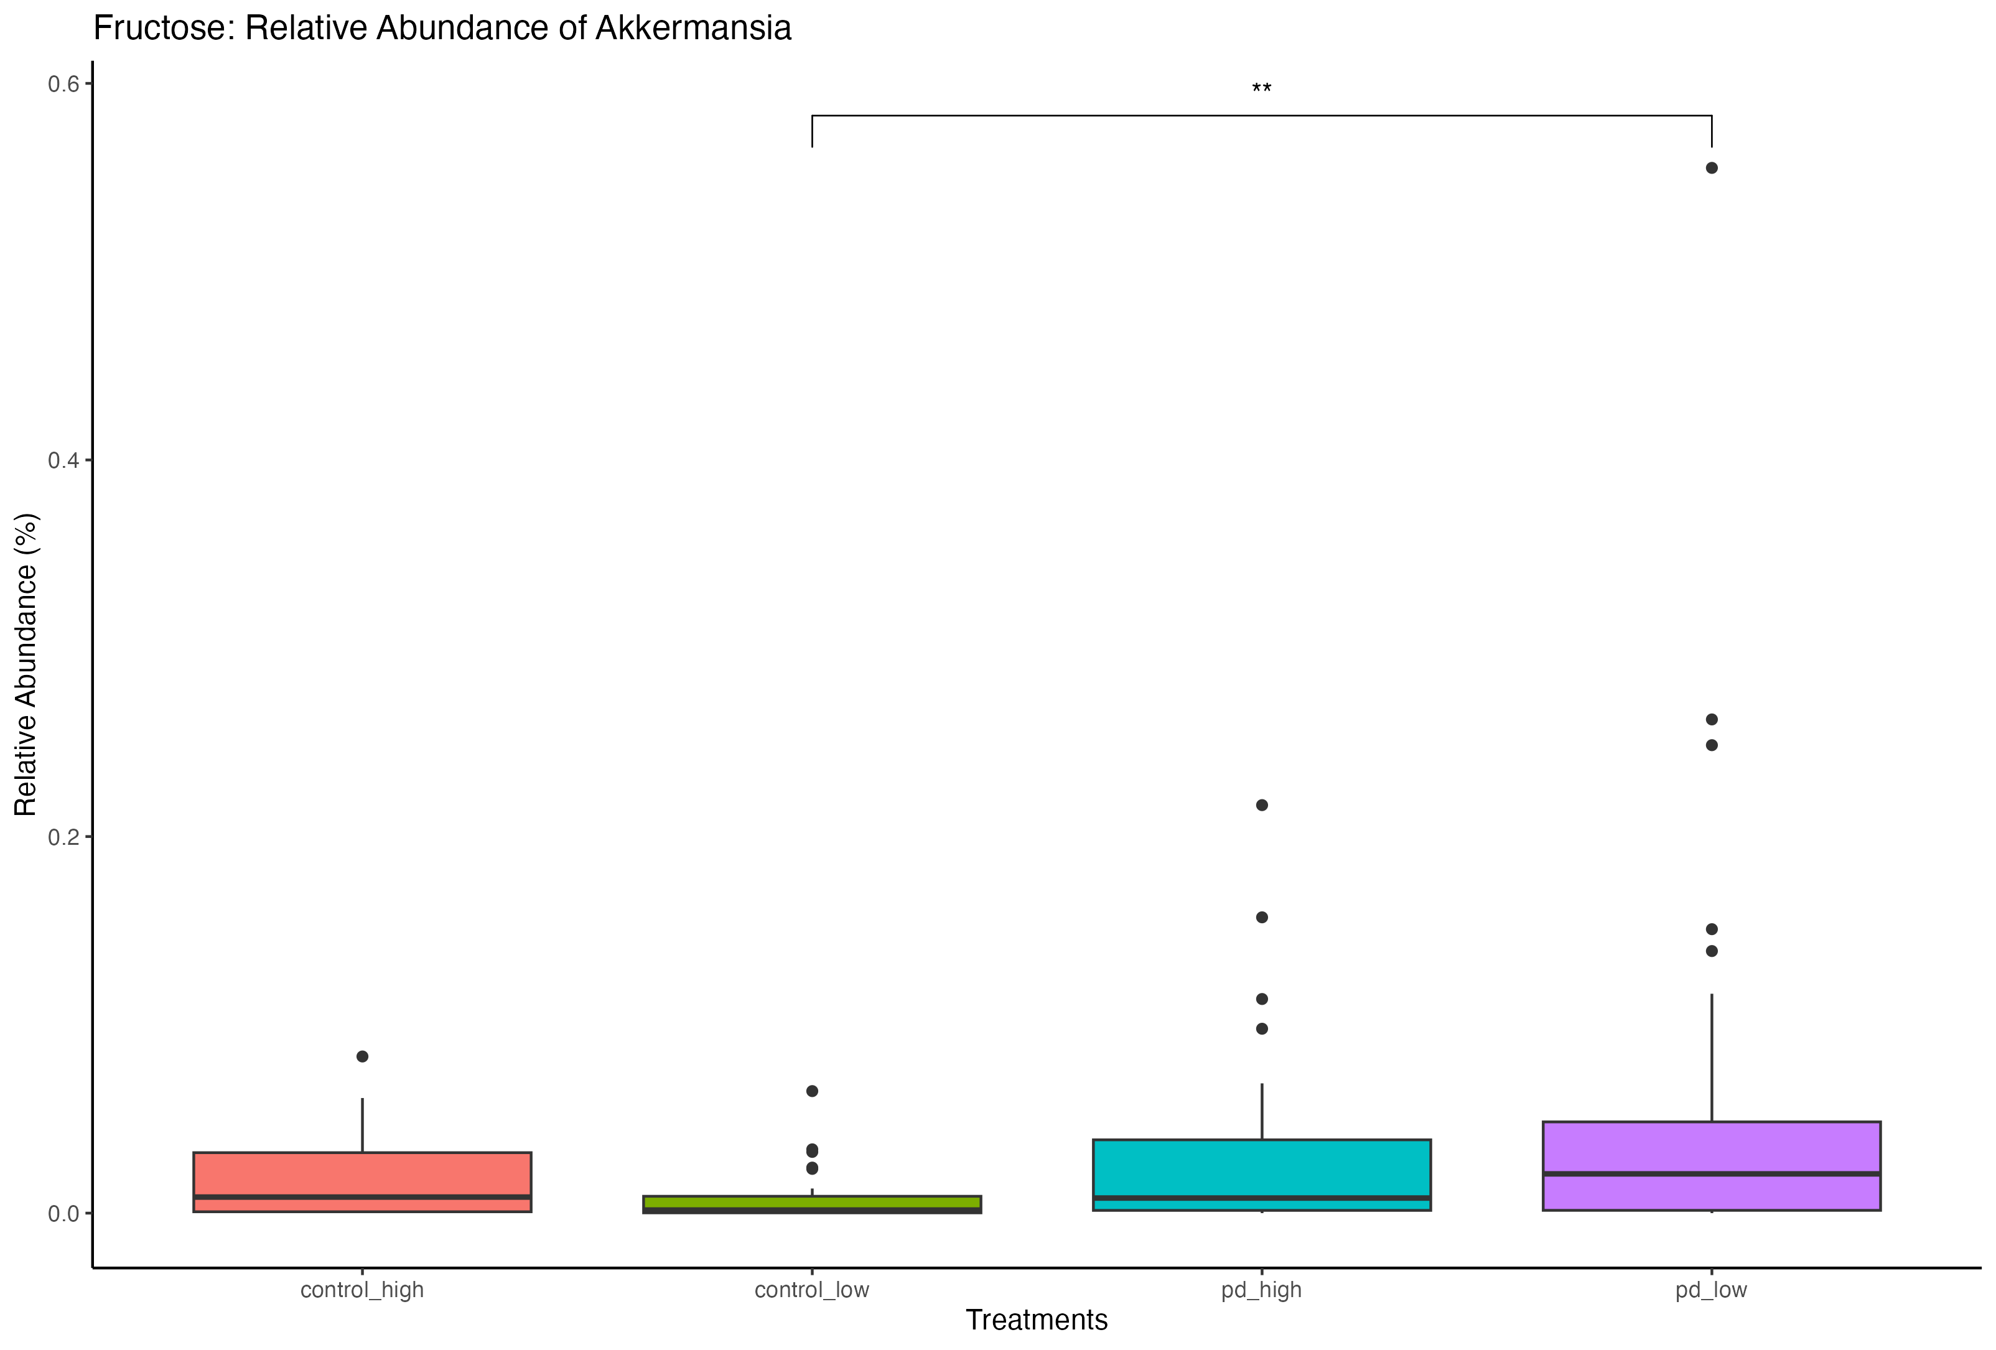
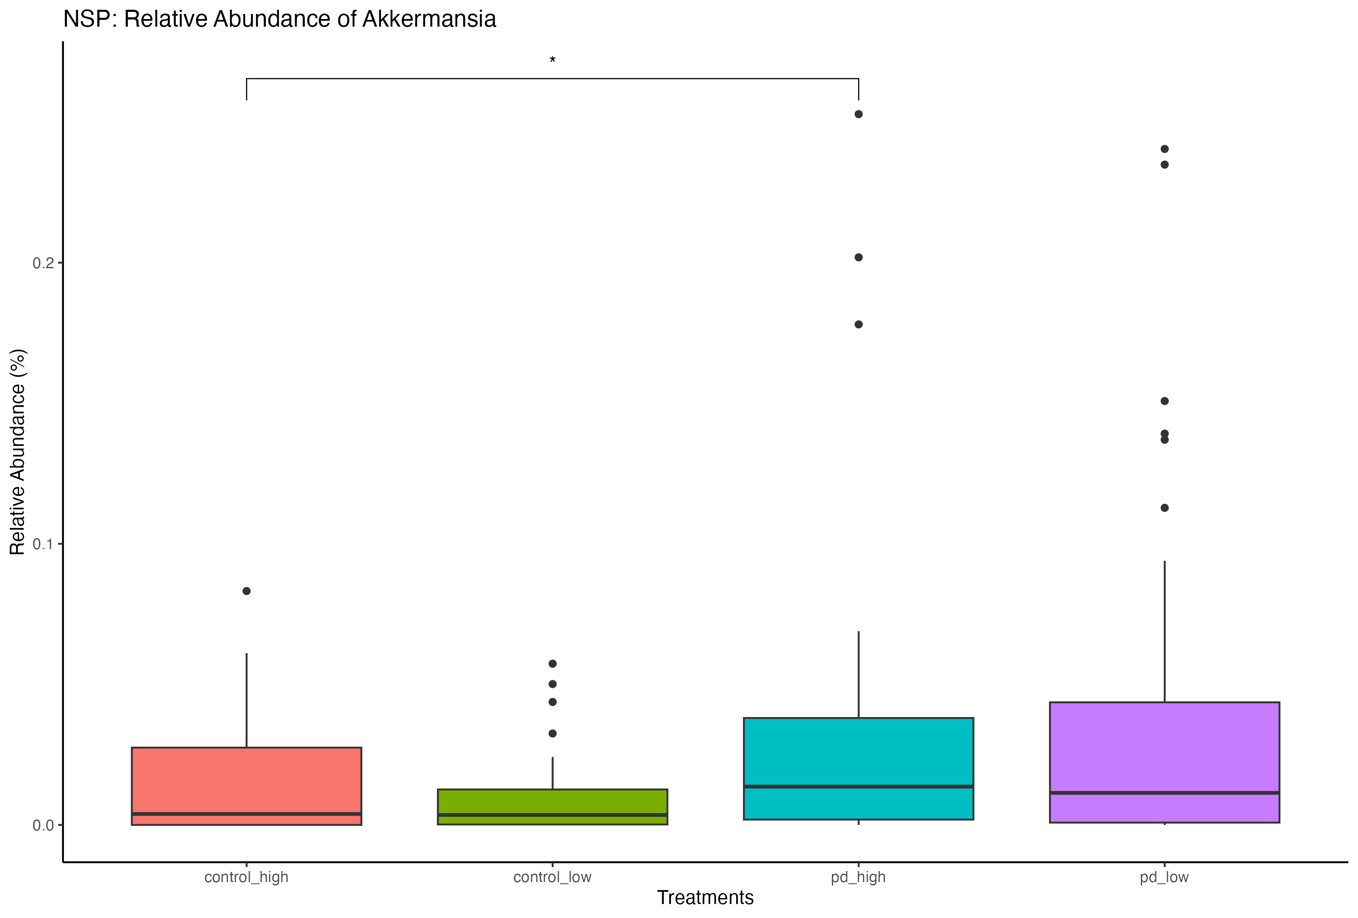
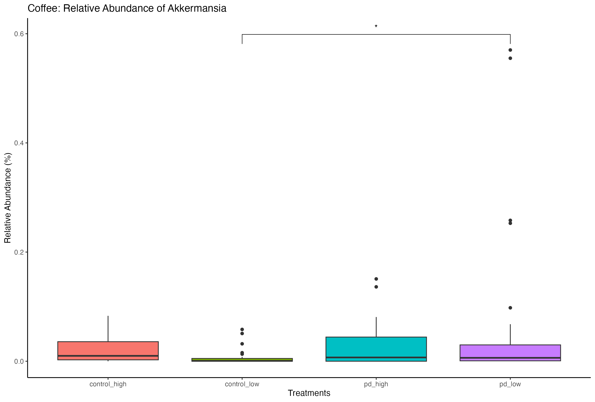
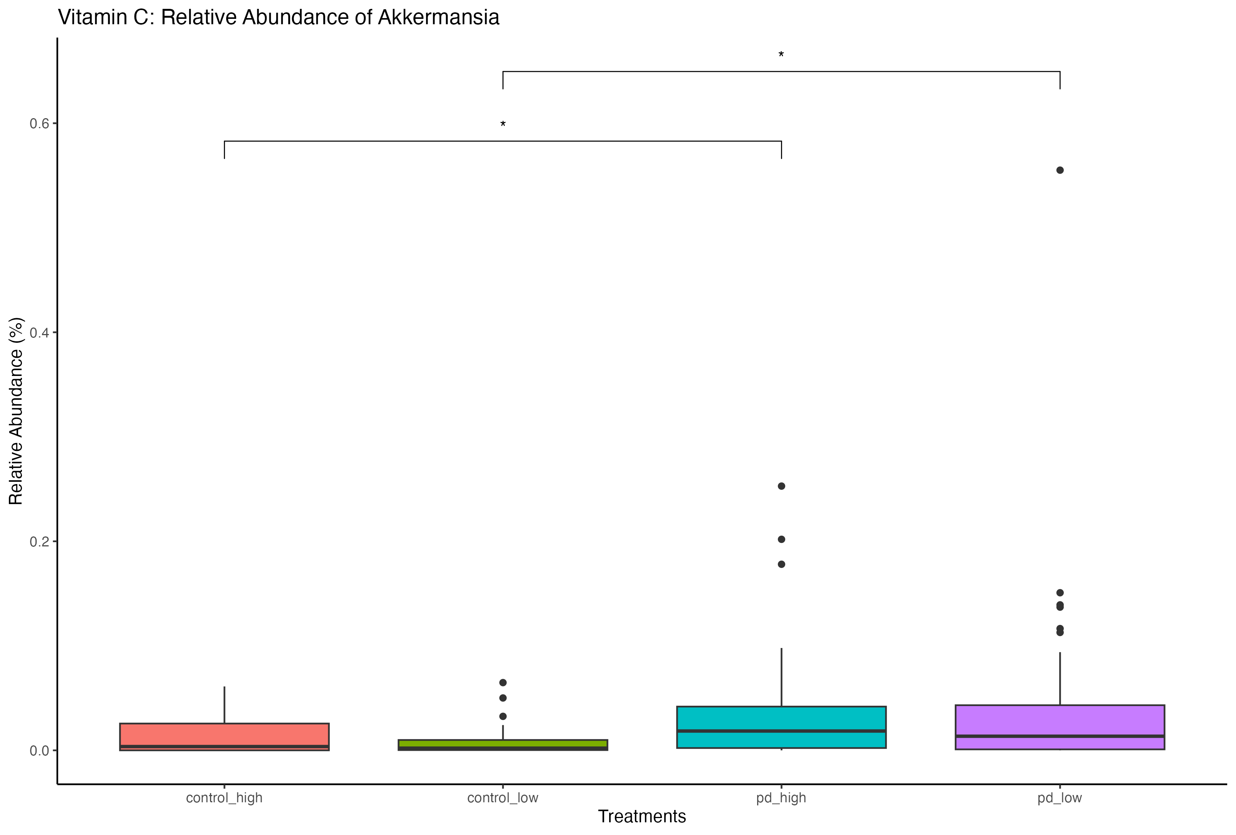
Akkermansia
Relative
Abundance
(Significant Results)
Pairwise Comparisons with Wilcoxon Tests
** p<0.01
* p<0.05

Slide 24
Alistipes
Many studies investigating Gut Microbiome and PD not elevated abundance of Alistipes.
Appears to be a benign commensal in the gut of a healthy individual, however, can cause infection and is linked to gut inflammation and disease.
https://www.sciencedirect.com/science/article/pii/S1075996420301396?via%3Dihub
https://www.nature.com/articles/s41531-021-00156-z
https://www.ncbi.nlm.nih.gov/pmc/articles/PMC9804059/
https://www.nature.com/articles/s41467-022-34667-x#:~:text=Despite%20differences%2C%20we%20confirmed%20their,also%20highly%20elevated%20in%20PD.
Our Findings
Upregulation of Alistipes in all PD nutrient groups.
Potentially suggesting that nutrient rich diets lead to elevated levels of Alistipes.

Slide 25
Alistipes Relative Abundance (Significant Results)
No Significant Nutrient Class

